Slide 1


Migrant Forum
On Family Reunification
Date: 20/05/2026
Presented by:
Tian Yu Lloyd
Neil Bruton

Slide 2


Who is MRCI?
MRCI is a national organisation working to advance the rights of migrant workers and their families at risk of exploitation, social exclusion and discrimination.
MRCI handle over 3,000 cases a year through our Information and Support Centre, which is a free and confidential service. We provide information, support, and advocacy on a wide variety of issues, including immigration rights and employment rights, work permit, via face-to-face, telephone, email and ongoing public awareness campaigns.
MRCI has been taking a stand with migrants to tackle the root causes of inequality since 2001.

Slide 3
Disclaimer
These materials have been prepared by the Migrant Rights Centre Ireland (MRCI) for information purposes only with no guarantee as to accuracy or applicability to a particular set of circumstances. The materials are not intended and should not be considered to be legal advice. The information given may change from time to time and may be out of date. The Migrant Rights Centre Ireland disclaims any legal responsibility for the content or the accuracy of the information provided. MRCI is not a practicing law centre.

Slide 4
Discussion Content / Overview/Agenda
01.
Definition
06.
Documents
02.
Sponsor Eligibility
07.
Adult dependents
03.
Family Members Eligibility
08.
Post-submission matters
04.
Financial Requirement
09.
Campaign for Change
05.
Minor Children
10.
Q&A

Slide 5
What is Family Reunification
Definition: Official process to bring close family to live with you long-term in Ireland
Ireland has no legal obligation to grant family reunification to non-EEA workers—it’s a privilege, not a right.
Only applies if your family is outside Ireland when you apply
Application fee: €60
❌ Not the same as short term visits to family

Slide 6
Are YOU Eligible to Sponsor?
Category | Sponsor Status | Examples | Waiting Period before application
Category A | Irish citizens or refugees | Irish passport holder; Refugees or subsidiary protection holder | No Wait
Category B | High-skilled/earning migrants | Critical Skills Permit, PhD student, doctor, researcher | No Wait
Category C | Other work permit holders and Stamp 4 holders | General Employment Permit, Reactivation EP, Stamp 4 from regularisation | One Year +

Slide 7
Who Can You Bring?
Spouse / civil partner / de facto partner (2+ years together)
Unmarried children under 18
Dependent adult relatives: Parents, adult children, siblings— who can not live independently, does not have financial or social support, and official verifiable medical documentation of serious medical or psychological condition must be submitted, after 0/2/5 years waiting period

Slide 8
Financial Requirement
General Principle
Only one sponsor's income will be considered
Declared and verifiable savings by the family member or sponsor may be taken into account
Figures in the policy paper are minimum requirements—not guarantees of approval
Sponsor must maintain required income levels and may need to prove this when renewing residency permission
Sponsor must not have relied mainly on Irish State supports for 2+ continuous years before applying

Slide 9
Category B
✅ No prior earnings needed Nuclear family may accompany sponsor on entry to Ireland
Supporting documents: Confirmation of the length of the sponsor’s employment and gross income for the current tax year.
Category A
✅ €40,000 minimum
Gross income (excluding State benefits), cumulative over 3 years before applying
Category C (Spouse/de facto partner only)
✅ €30,000 minimum in the previous year with the expectation that this level of income will be maintained.
Supporting documents: Employment Detail Summaries, Confirmation of the length of the sponsor’s employment and gross income for the current tax year

Slide 10
Category C (Minor Children)
Net income must be in line with the Working Family Payment (WFP)
Children | WFP Weekly | WFP 2026 | Gross needed 2026
1 child | €765 | 39,780 | 50,200
2 children | €866 | 45,032 | 60,200
3 children | €967 | 50,284 | 70,100
4 children | €1,058 | 55,016 | 80,000
5 children | €1,184 | 61,568 | 93,700

Slide 11
Documents
Application form | Signed and dated summary visa application form (AVATS)
Applicant’s identity | Valid passport (all pages, including blank, valid for at least 12 months) 2 recent passport photos (35mm × 45mm, name & visa reference number on the back)
Signed applicant’s Application letter | Applicant’s full contact details Reason for coming to Ireland Name, address and immigration status of the sponsor Details of any other family members who are currently in Ireland/UK/EU
Relationship proof | Spouse/partner: Marriage/civil partnership cert + evidence of genuine & subsisting relationship (joint bills, photos, chat/call logs, travel together). A relationship must include face-to-face meetings between the parties. Child: Birth cert/ adoption order showing sponsor as parent, Parental consent (if other parent is alive and has rights): Sworn affidavit from other parent + copy of their ID
Sponsor’s documents | Current IRP card (front/back) Passport (all pages, including blank) Work permit/hosting agreement/other documents reflecting immigration status
Financial evidence | Category A/C: Employment Detail Summaries, 3 recent payslips, Contract Category B: supporting documentation confirming the length of employment and gross income for the current tax year Up to date 6 months bank statements (both applicant and sponsor's accounts) Financial dependency
Accommodation | • Lease/mortgage agreement • Letter from landlord

Slide 12
Cont. Documents
Evidence of dependency
Documentary evidence may vary from case to case; however, evidence of the following will normally be relevant:
  Amount, frequency and duration of the financial support provided from sponsor to applicant (bank statement, money transfer receipts, etc)
  Applicants' other sources of income that you may have
  If you have no other source of income, evidence of why you are unable to work, why you are not eligible for state benefits
  Your living costs (evidence of mortgage or rent, utility, food, medical, education payments)
  Details of any other family members in your country of residence
  Your medical condition (where relevant), relationship with the sponsor including evidence of active and continuous involvement in your life, for example evidence of visits or correspondence.

Slide 13
Cont. Documents
Medical or travel insurance
Evidence of medical or travel insurance does not need to be provided with your application. However, the Visa Officer may request it before they make a decision on your application.
If your visa is approved, you must have evidence of medical or travel insurance when you arrive at the port of entry (airport or seaport) and must present it to the Immigration Officer on request.
Previous Visa Refusals
If you have been refused a visa in the past for any country, you must provide the details. The original letter issued to you by the authorities of that country must be provided with your application.

Slide 14
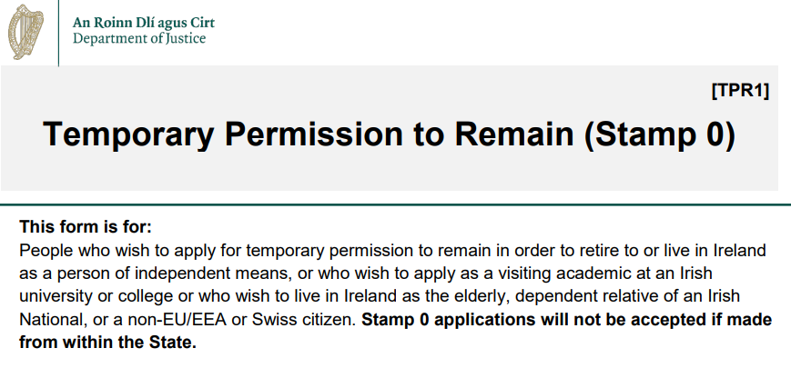
Adult Dependents
Must apply for Stamp 0 from abroad → receive conditional letter of offer
Other Essentials:
☑️ Details of all family members resident in the State including legal status
☑️ Suitable Accommodation
☑️ Police Clearence
☑️ Health Declaration (eg a letter from your local doctor informing of your present state of health).
☑️ Future intentions: Short statement explaining why need to reside in Ireland
☑️ Sponsor finances: 3 years of EDS/payslips + 6 months bank statements
Number of Dependent Adult Relatives | Minimum Annual Gross Salary Required (2025)
1 | €92,789
2 | €125,390
3 | €157,992

Slide 15
Appeal
If the visa application is refused, an explanation for the refusal must be given in writing and you have the right to appeal any refusal within two months of receiving the refusal letter
Visa applications can be refused for several reasons but the most common reasons we identify are;
  ❌ Sponsor does not meet the financial requirement
  ❌ Not enough supporting evidence of the relationship between applicant and sponsor
  ❌ Applying while family is already in Ireland on a visitor visa
  ❌ Submitting unattested marriage/birth certificates
  ❌ Incomplete or unsigned forms
Appeal
Appeal

Slide 16
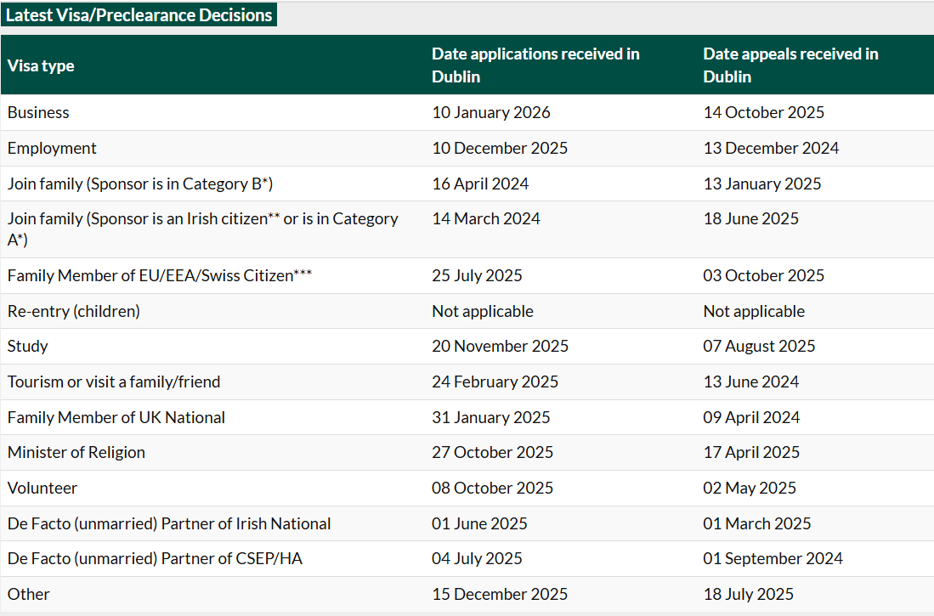
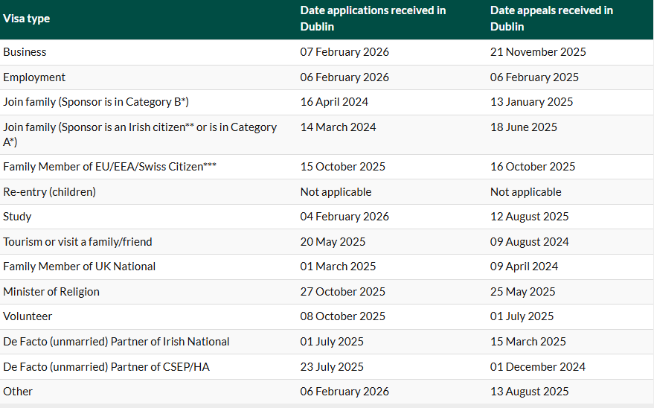
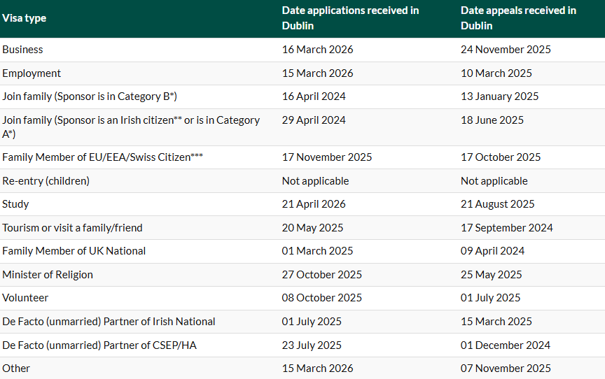
Current Processing Times

Slide 17
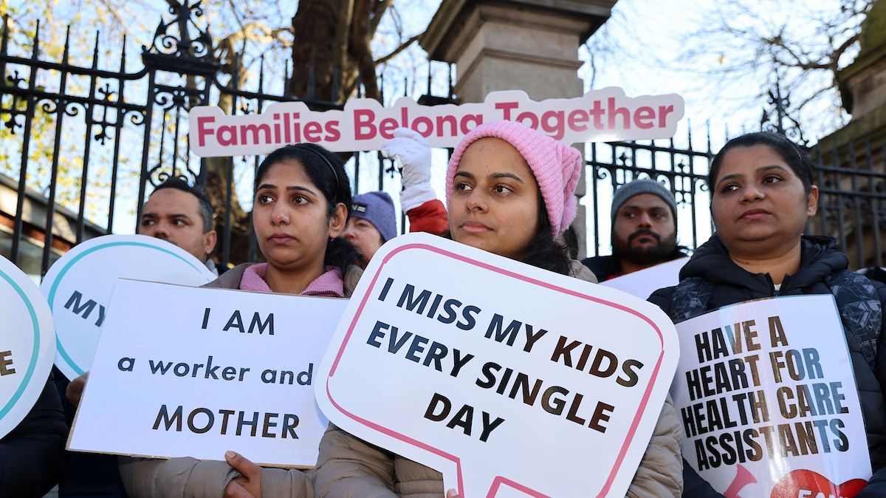

Slide 18
Campaign 2026
The family reunion campaign is a community of over 1,000 migrant workers affected by family reunion rules.
We are calling on the government to scrap the 12 month wait and scrap the salary thresholds.
Two Key Actions in 2026
Submission to Department of Justice
Families Belong Together National Lobby Action

Slide 19
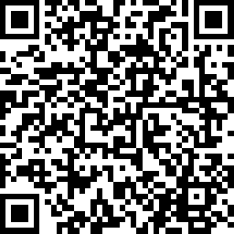
Campaign 2026
Submission to Department of Justice
Feedback on changes – Survey of workers
Support from allies
Your participation (letter to employers)
Our demands

Slide 20
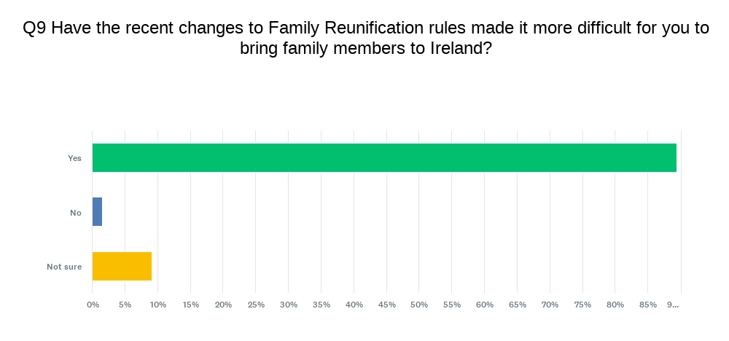

Slide 21
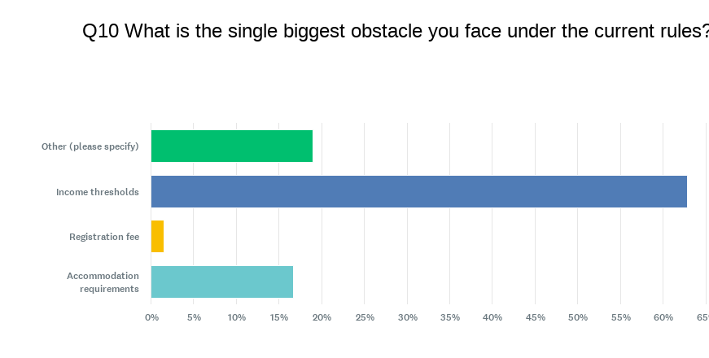

Slide 22
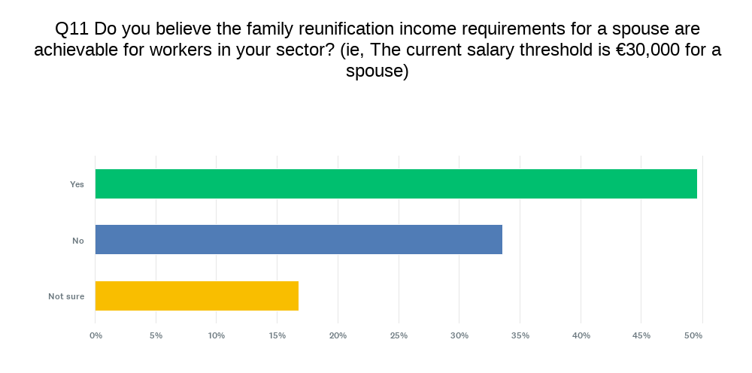

Slide 23
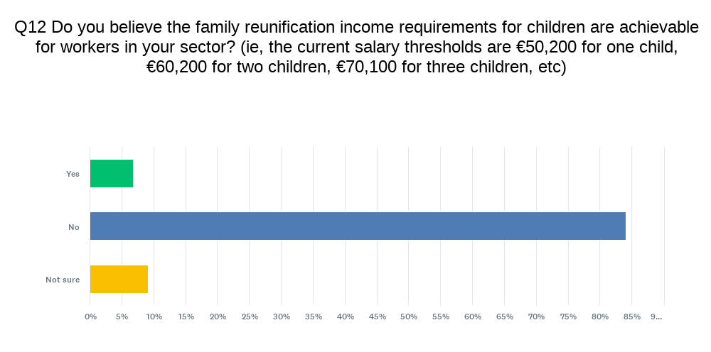

Slide 24
How has being separated from your family affected you personally or professionally?
"The past three years of separation from my family have been the most challenging experience of my life. For as long as I can remember, I have lived apart from them, with only brief holidays to bridge the distance. The sole reason I keep going is my role as an economic migrant; my purpose is to provide for my family, and they are the driving force behind every step I take. However, the journey is incredibly difficult. It feels fundamentally unfair that those who make the rules and regulations. The very people shaping our lives are creating a system that makes this path so much harder for us to navigate."

Slide 25
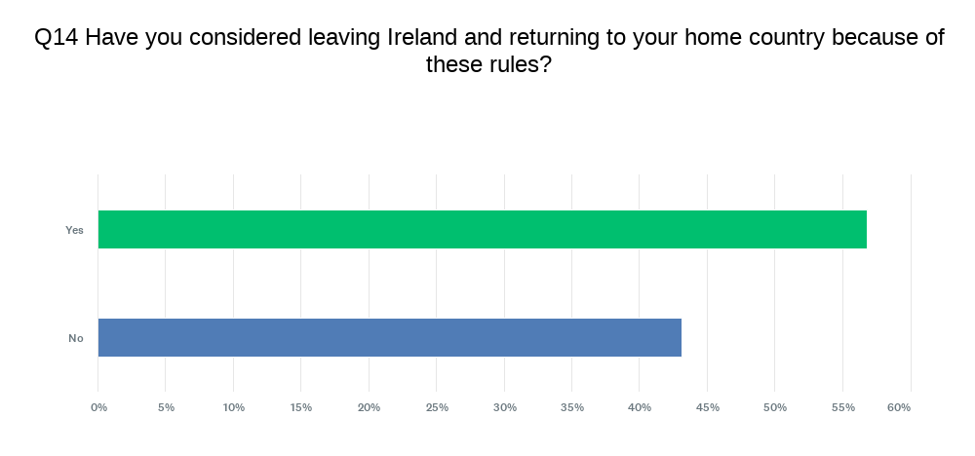

Slide 26
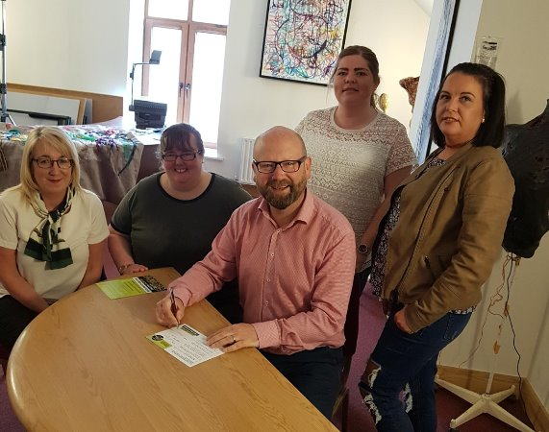
Campaign 2026
National Family Reunion Lobby Campaign
Taking place in June/July 2026
Registration of supporters
Training and support
Postcard

Slide 27
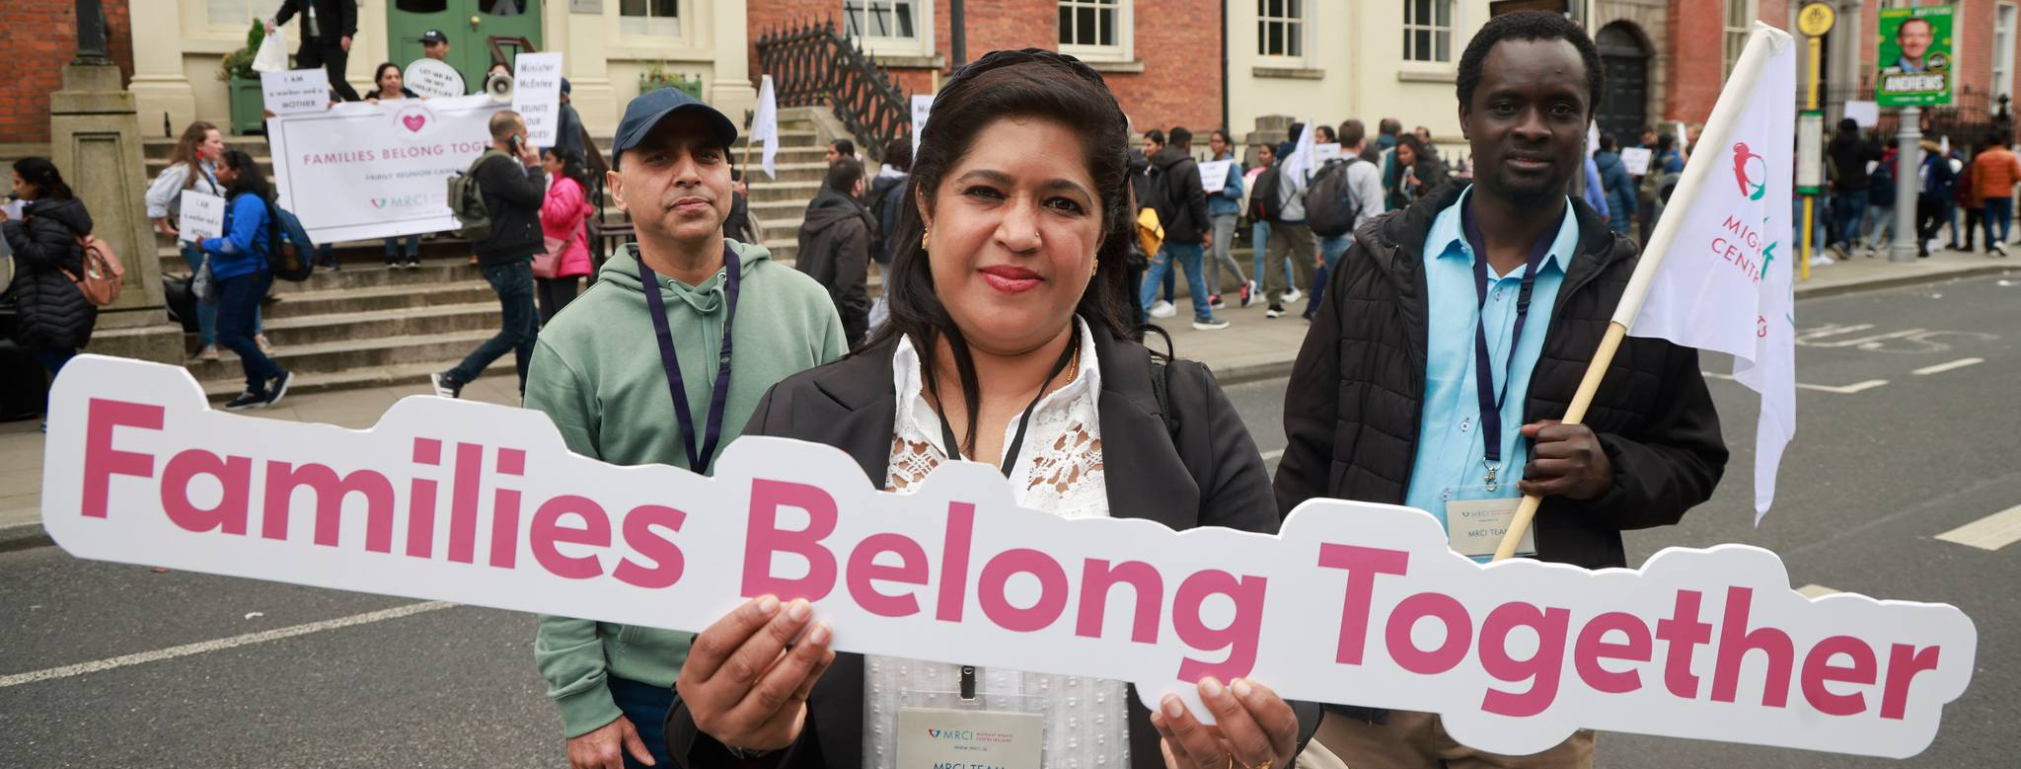
Will you support family reunification for migrant workers in Ireland?
[ ] Will you write to the Minister for Justice requesting he:
    Scrap the income thresholds for family reunification?
    Abolish the 12-month waiting period?
I commit to supporting Family Reunion
_____________________________________ TD

Slide 28

Campaign 2026
Visit Constituencies
43 across Ireland
Concentrate on Fianna Fail
Public campaign – Social media, media, videos, etc
Build a database of activists

Slide 29
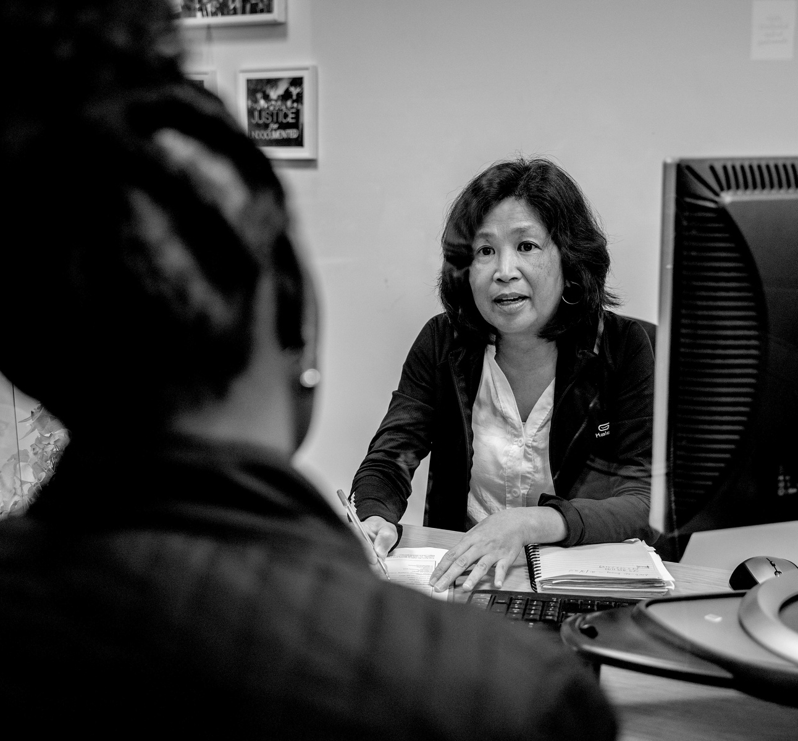
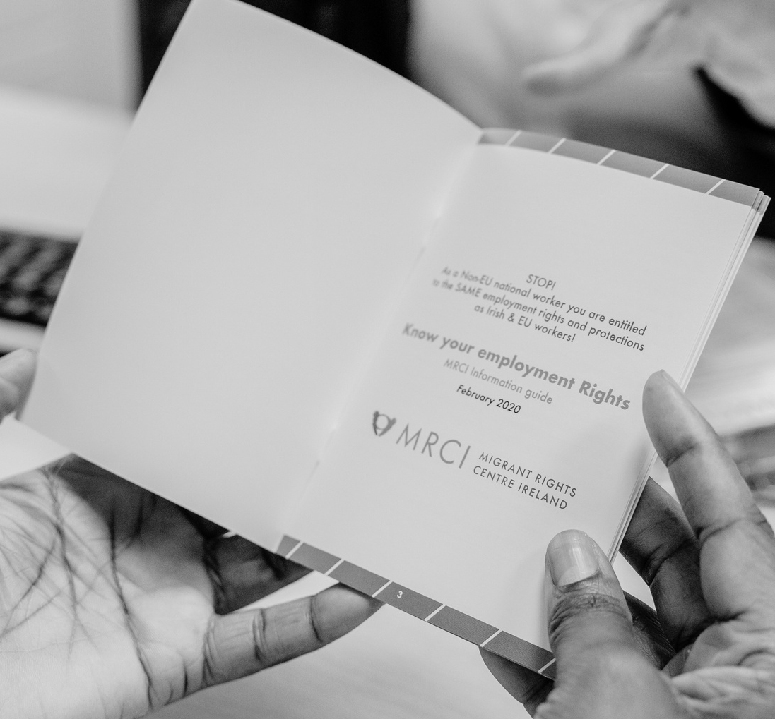
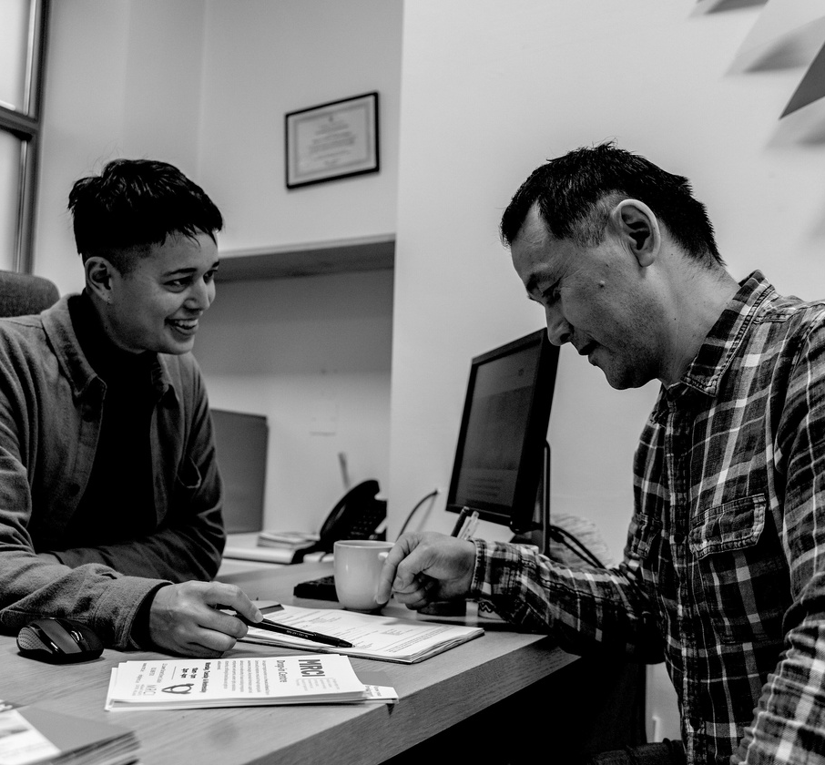
Q&A Session
Please ask any questions.

Slide 30
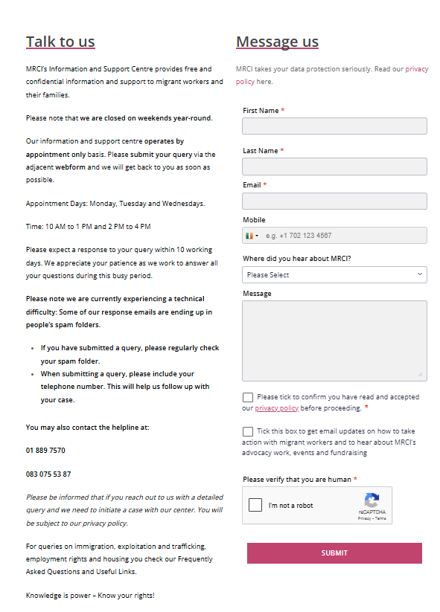
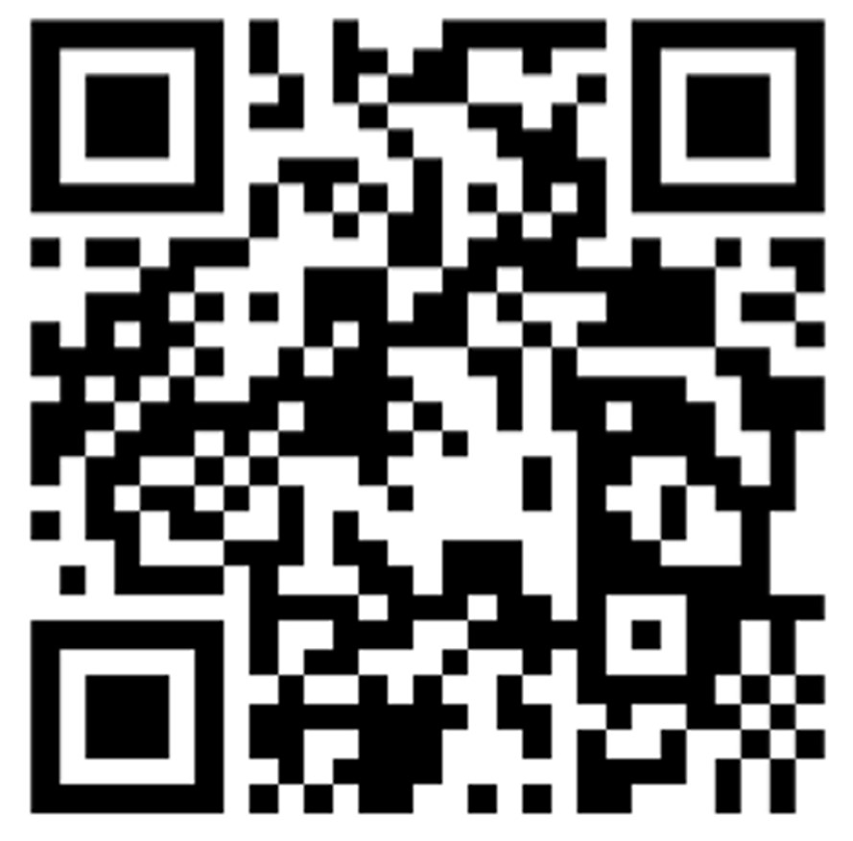
Information and Support Centre
www.mrci.ie/contact-us
Our Information and Support Centre is currently running on an appointment basis.
If you would like to speak to us, the best way to get in touch is by sending us a message via the Contact Page on our website!

Slide 31
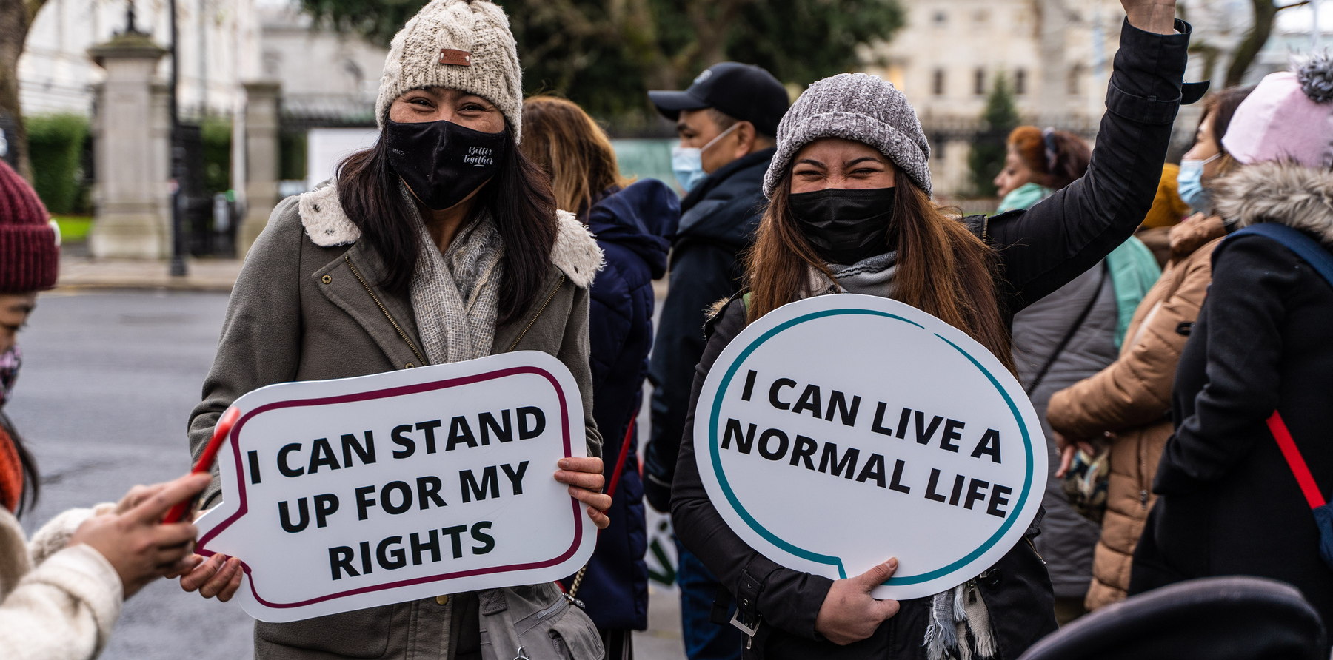
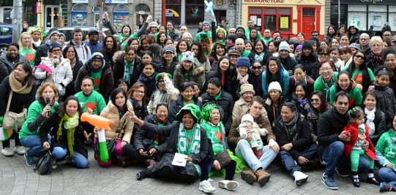
Join our campaigns
www.mrci.ie/our-work
Get Involved
Sign up as a supporter
www.mrci.ie/#signup
Donate
https://www.mrci.ie/donate/
Join Us Today!

Slide 32
For Regular Updates
Follow us on Social Media
Website
www.mrci.ie

Slide 33
THANK YOU

