Slide 1
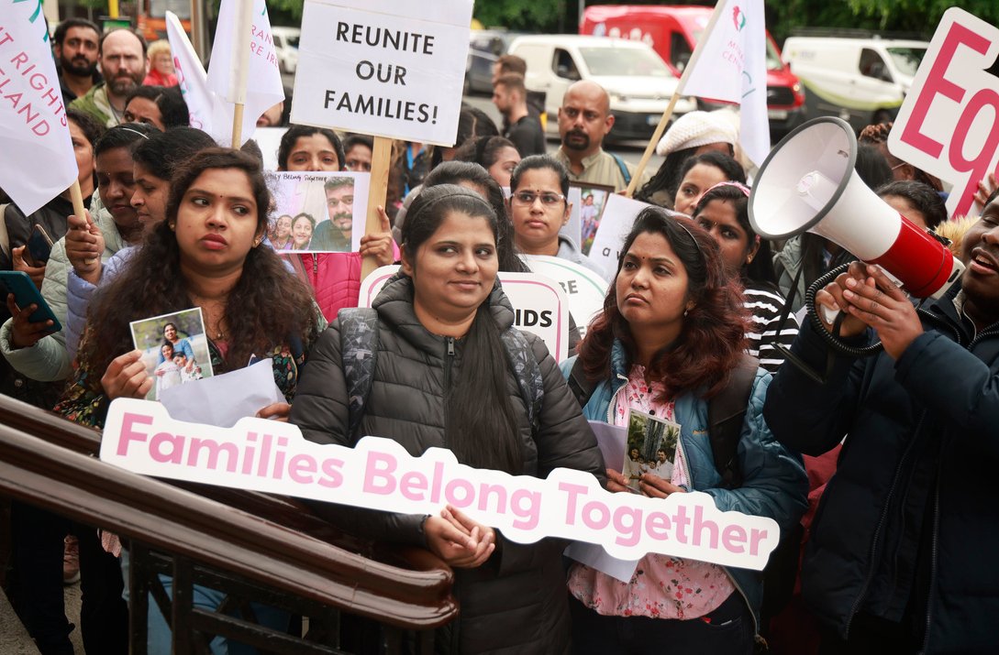








Slide 2

Labour Exploitation
15 October 2025
Presented by:
Pretty Ndawo &
Sylwia Nowakowska

Slide 3

Who Are We?
Set up in 2001, the Migrant Rights Centre Ireland (MRCI) is the leading national organisation working with migrant workers in low-paid and precarious sectors of the economy.
We work with carers, meat factory workers, agriculture workers, chefs, drivers and others at risk of exploitation and unfair treatment.
We work at the intersection of migration and employment.

Slide 4


Casework
Our Information and Support Centre provides high quality casework supports to migrant workers
and their families. We supported over 3,400 cases in 2024 with some of the most common issues being registration of immigration permission, employment permit issues, change of status, family reunification, citizenship, regularisation and employment issues.

Slide 5

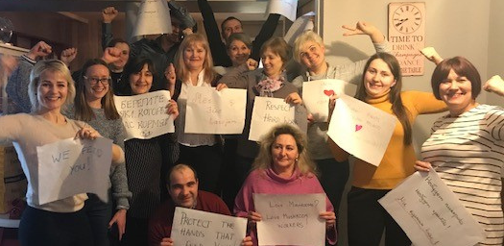
A community work approach underpins our work, which supports migrants themselves to
advance social justice issues. MRCI brings people together around issues that affect them
personally. We support them to develop the skills, knowledge and power to advocate for
policy change that makes a huge difference to the lives of thousands of migrant workers.
Community Work
“Those closest to the problem, are closest to the solution”

Slide 6
National Minimum Wage
The current National Minimum Wage is €13.50 per hour.
A worker's hourly rate can be calculated it by dividing your pay by the number of hours worked in the relevant pay period.
Every employer is required to pay the National Minimum wage
However, there are exceptions such security, contract cleaners, early learning and childcare and construction workers.
Notes:
Rates can be found on the WRC website

Slide 7
Daily Rest Period
A worker is entitled to a daily rest period of at least 11 consecutive hours between your shifts.
Breaks
A worker is entitled to a minimum of 15 minutes break for working more than 4 hours and 30 minutes
An employer should not require a worker to work for more than 6 hours without a break of at least 30 minutes.
Weekly Rest Period
A worker is entitled to at least 24 consecutive hours rest period in each period of 7 days.
Maximum working hours
An employer may not allow a worker to work above an average of 48 hours in each 7-day period.
Sunday Premium
A worker that performs Sunday work is entitled to additional payment.
Entitlements
Notes:
There is not set amount for Sunday premium
Split shifts aren’t allowed

Slide 8
Annual Leave
A worker is entitled to annual leave calculated at 8% of the hours an employer works in a leave year.
Sick Leave
A worker is entitled to 5 days statutory sick pay after 13 weeks of employment.
Public/Bank Holidays
A worker is entitled to either a paid day off on the holiday, a paid day off within a month or an extra day’s annual leave or an extra day’s pay should the employer decide to do so.
Entitlements
Notes:
AL: Maximum of 4 weeks
10 Bank holidays per year

Slide 9
Overview
Payslip
A worker is entitled to receive his/her payslip with each payment of wages by the employer (weekly, biweekly or monthly).
Payslip should detail the gross wages and deductions on the worker’s wage.
Employment contract
An employer should furnish a worker with the terms of the employment within four weeks of the employment
An employer must provide a worker with notice when there is a change to the terms of his/her employment.
Notes:
Workers should also refer to the staff handbook for company policies
Contract should contain entitlement: pay, working hours, location, role etc

Slide 10

Labour Exploitation
What is labour exploitation?
Labour exploitation refers to:
being forced/coerced to provide a service (s) to another person,
Being subjected to forced labour,
Enslavement or subjecting an individual to servitude or similar conditions
Notes:
These indicators can vary on severity wherein the conduct can be considered as severe labour exploitation.

Slide 11
Labour Exploitation
Indicators of labour exploitation
Receiving no pay or being paid significantly below the Minimum Wage
Excessive working hours (above 48 hours average per week)
Large pay deductions or debt repayments back to employer
Little or no breaks during shifts
Few or no days off per week
No annual leave entitlements
Notes:
These indicators can vary on severity wherein the conduct can be considered as severe labour exploitation.

Slide 12
Labour exploitation
Factors of vulnerability
Dependence on employer for…
  Employment permit and immigration status
  Accommodation
  All income
Language barriers
Lack of knowledge of rights and options
Lack of wider social safety net
Large debt repayments
Threats to themselves or family (physical or deportation)
Control of documents such as passport, bank account, IRP card
Notes:
Growing and increasingly common. Some paid up to 3k to 40k
If found person paid employer then it can be raised directly with employer.
If paid agent then it is less straightforward.
But employers are vulnerable here and it is an issue worth engaging.

Slide 13
Recruitment fees
Paying for the job
It is illegal for an employer to deduct or seek payment for cost of permit, any recruitment related expense or travelling expenses regarding the taking up an employment
Use of recruitment agencies - Employer pays principle in law
Difficulty to enforce if fees were paid abroad
Notes:
Growing and increasingly common. Some paid up to 3k to 40k
If found person paid employer then it can be raised directly with employer.
If paid agent then it is less straightforward.
But employers are vulnerable here and it is an issue worth engaging.

Slide 14
Raising a grievance
How to approach employer
First refer to your contract/staff handbook on the grievance procedure
Verbal conversations with supervisor/manager should be followed up in writing
Exhaust all internal options where possible
Useful evidence to gather:
Photos of start and finish times/ Roosters
Contract of employment/Permit/Revenue docs
Payslips
Communication with employer (emails; text messages; whatsApp messages etc)

Slide 15
Workplace Relations Commission (WRC)
Inspections
The WRC has inspectors who conduct inspections in workplaces.
These inspections exist to investigate potential employment law breaches.
Workers can anonymously report an employer for the WRC to inspect that workplace.
Inspectors will make recommendations depending on the outcome of their investigation.
Adjudications
Process where an appointed adjudicator investigates and decides on complaints made my workers.
For a complaint to be considered for adjudication, workers need to file complaint form.

Slide 16
Adjudication cont’d
Adjudication cont’d
Adjudications
The adjudicator will decide on the breaches and determines monies owed.
Please note that this process does take time. It might be months before a hearing date is set, and a decision is given on your complaint.
Please note: There are time limits associated with bringing complaints to the WRC. Complaints should be submitted ASAP or within 6 months of ending employment
Notes:
Line: 1800 666 111

Slide 17

WRC complaint form
Notes:
Line: 1800 666 111

Slide 18
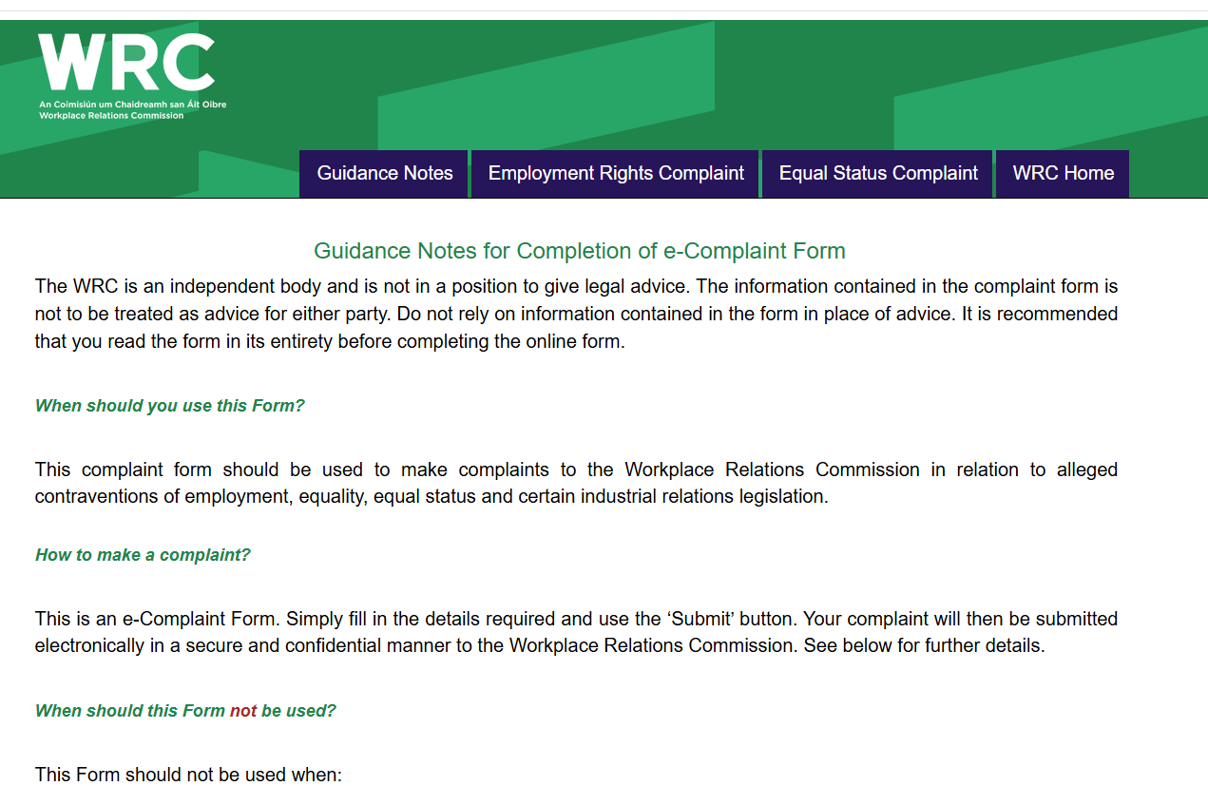
WRC complaint form
Notes:
Line: 1800 666 111

Slide 19
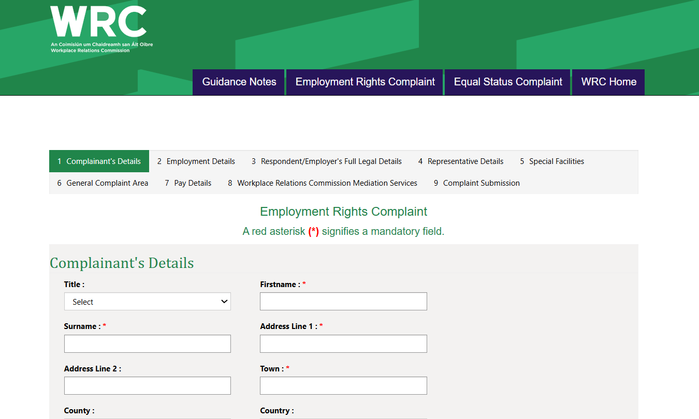
WRC complaint form
Notes:
Go through no.2-5

Slide 20
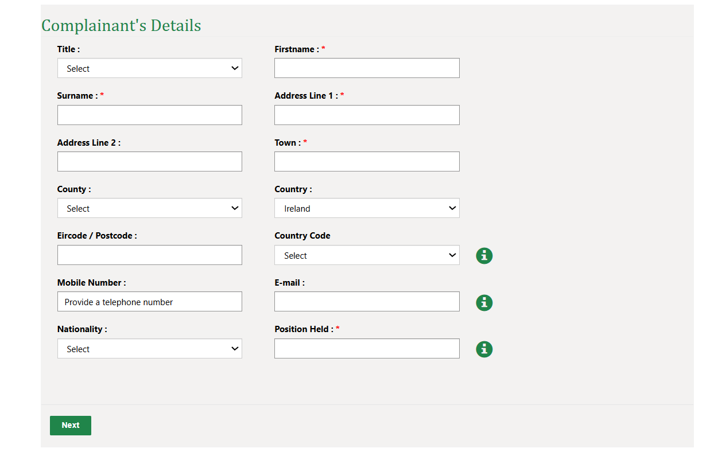
WRC complaint form
Notes:
Line: 1800 666 111

Slide 21
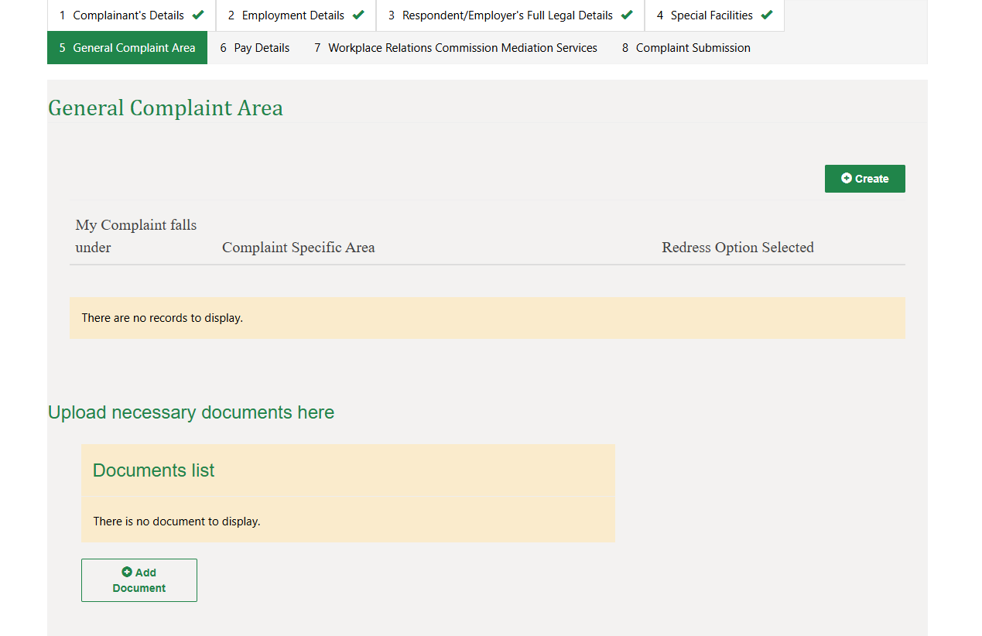
WRC complaint form
Notes:
Line: 1800 666 111

Slide 22
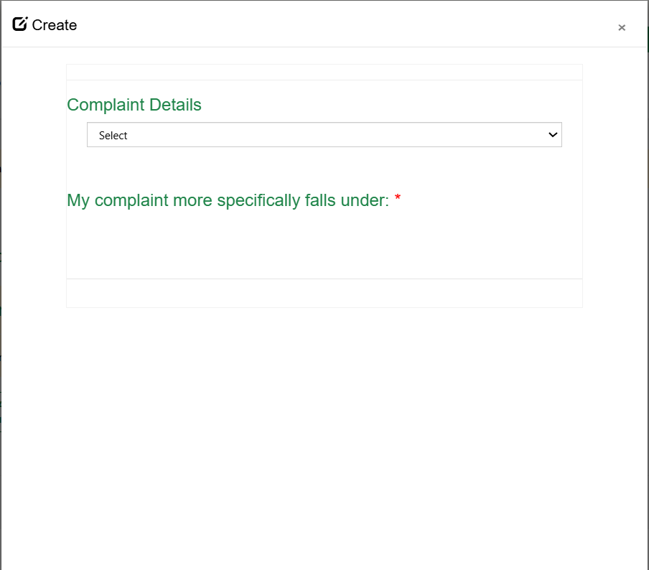
WRC complaint form
Notes:
Line: 1800 666 111

Slide 23
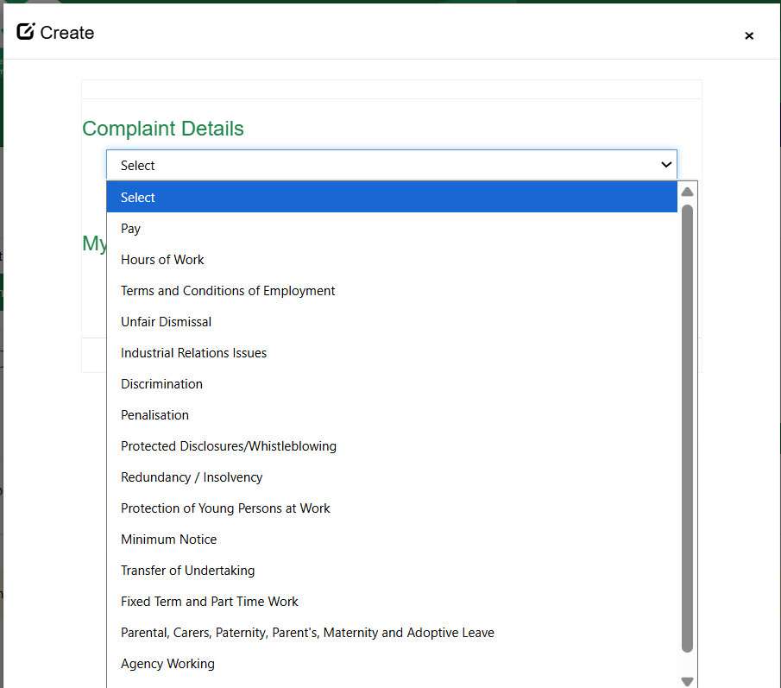
WRC complaint form
Notes:
Line: 1800 666 111

Slide 24
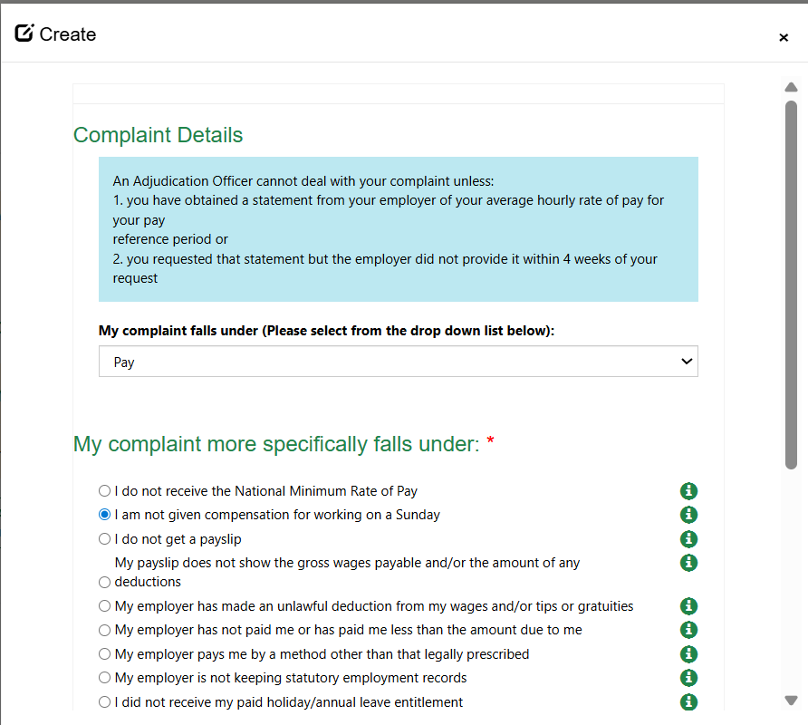
WRC complaint form
Notes:
Line: 1800 666 111

Slide 25
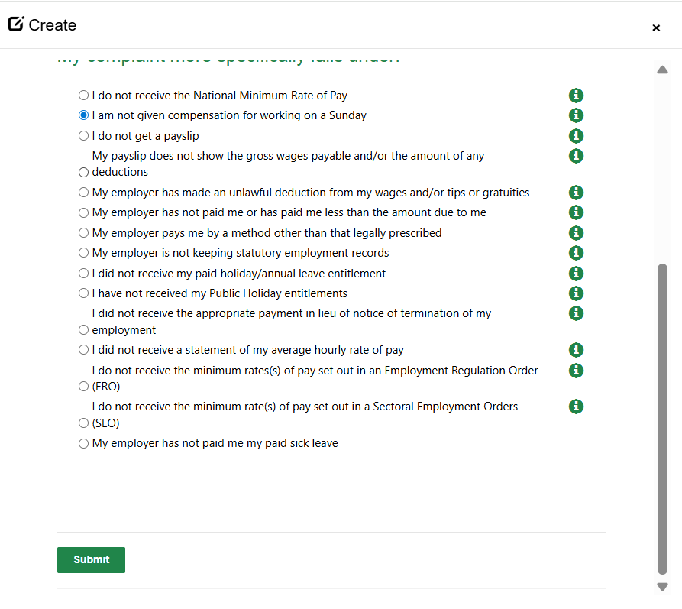
WRC complaint form
Notes:
Line: 1800 666 111

Slide 26
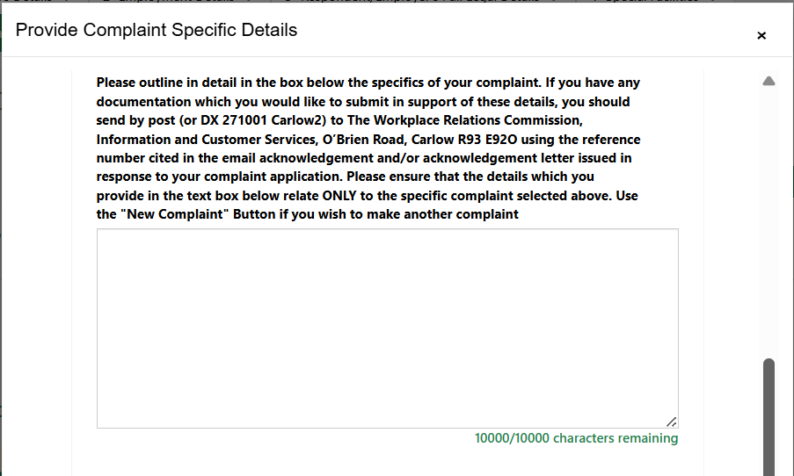
WRC complaint form
Notes:
Line: 1800 666 111

Slide 27
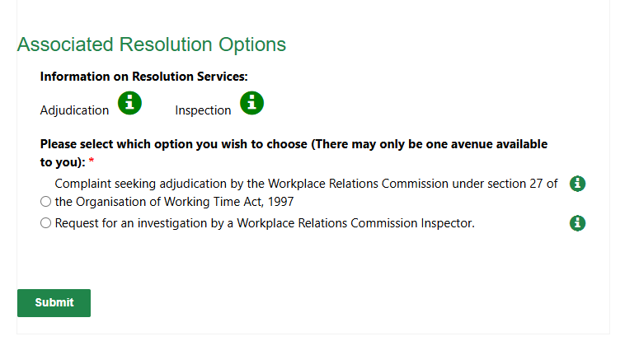
WRC complaint form
Notes:
Line: 1800 666 111

Slide 28
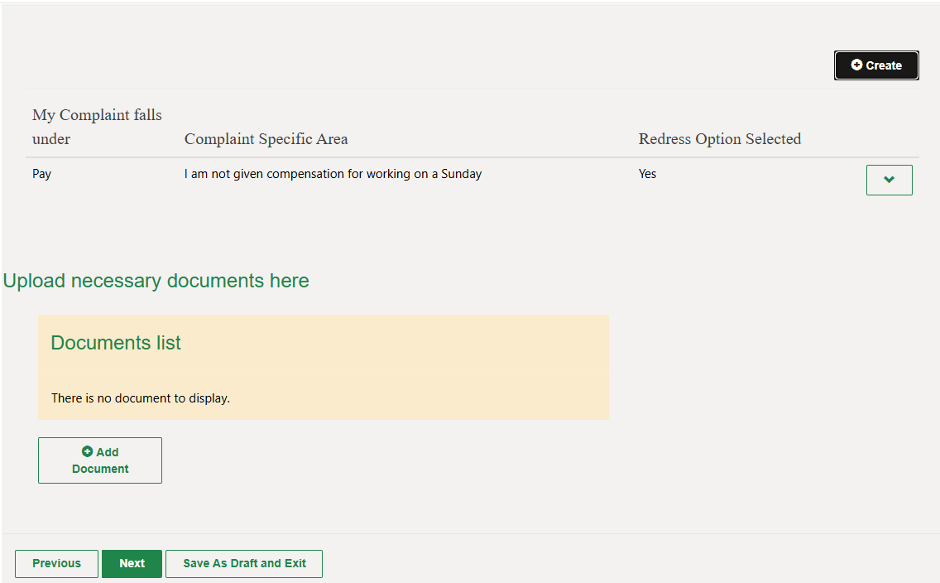
WRC complaint form
Notes:
Line: 1800 666 111

Slide 29
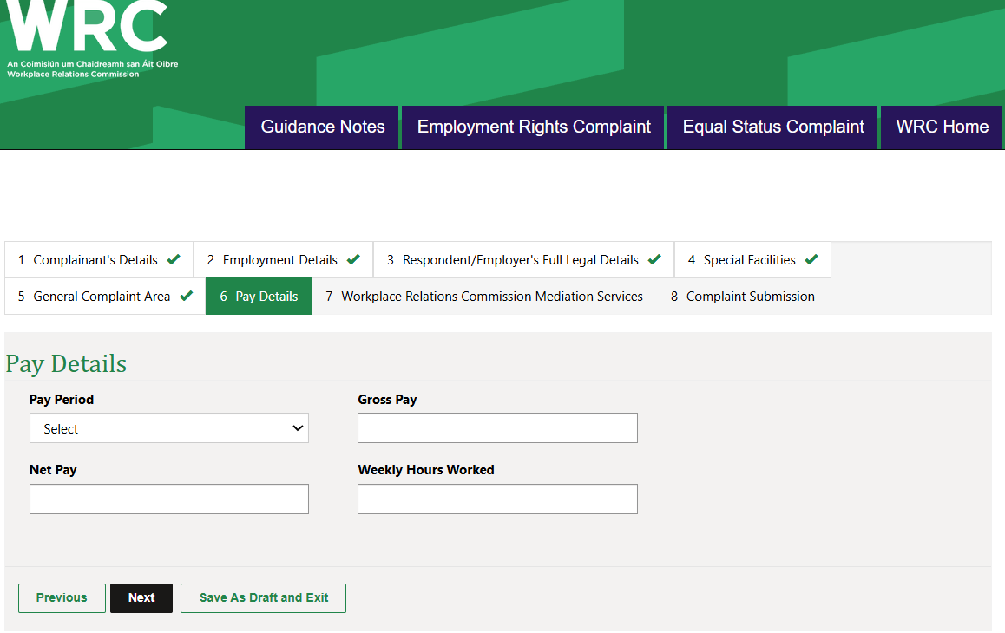
WRC complaint form
Notes:
Line: 1800 666 111

Slide 30
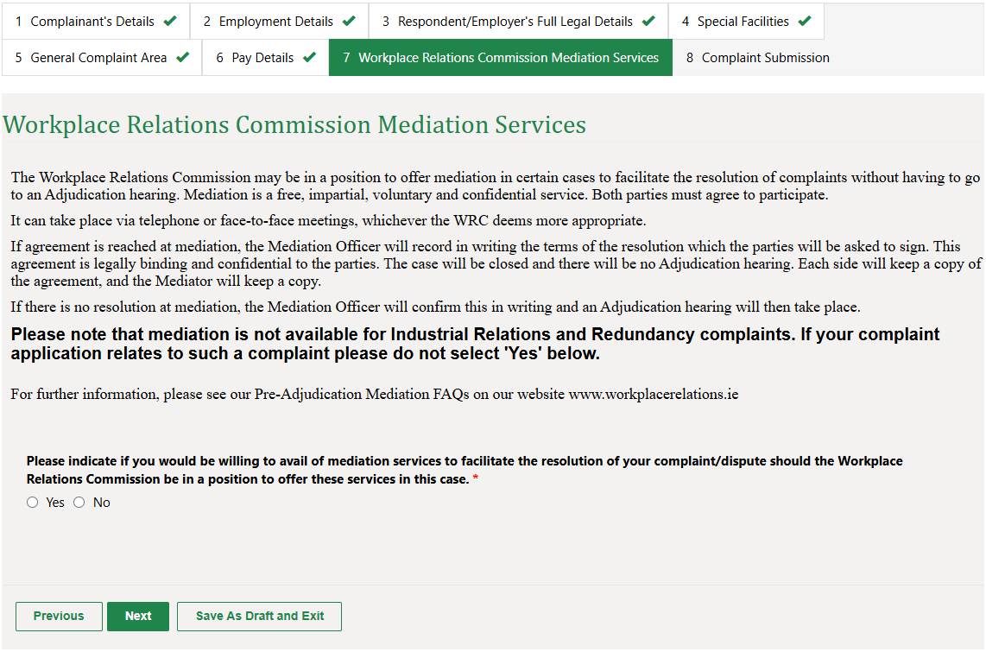
WRC complaint form
Notes:
Line: 1800 666 111

Slide 31
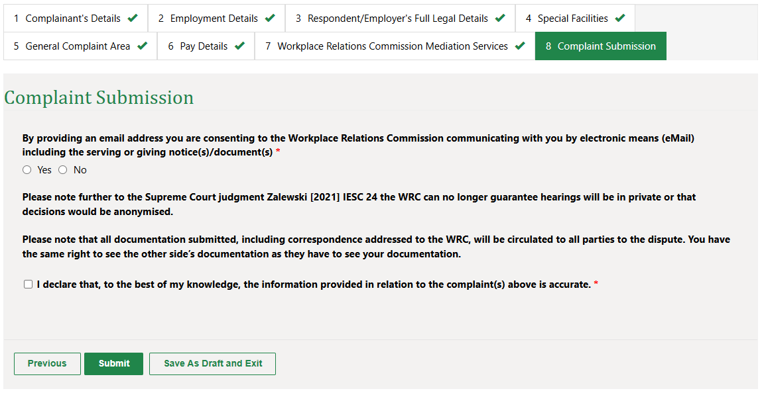
WRC complaint form
Notes:
Line: 1800 666 111

Slide 32
MRCI Support Work
MRCI can help you with:
  Provide options that enable people to leave (CoE, Reactivation)
  Submitting claims to the WRC
  Emergency needs supports
  Advocacy with immigration status
  Assistance securing new employment
  Advocacy with social welfare, health
  Assessment and referrals to Gardai in cases of suspected trafficking situations (range of supports)
Notes:
Assist with moving to a new employer.

Slide 33
MRCI Support Work
Campaigns
Employment permit
Focuses on making the employment permit systems equal for all permit holders.
Can join campaign on our website
Ongoing survey for employment permit holders to complete to assist in our asks to the Department of Enterprise, Tourism and Employment.
Family Reunion
Focuses on bringing families together without the delays currently imposed on general employment permit holders
Fair fees: Irish Residence Permit fee
JFU: Seeks a pathway to papers for all undocumented people in Ireland. We believe that if you live here, you belong here.
Notes:
Assist with moving to a new employer.

Slide 34
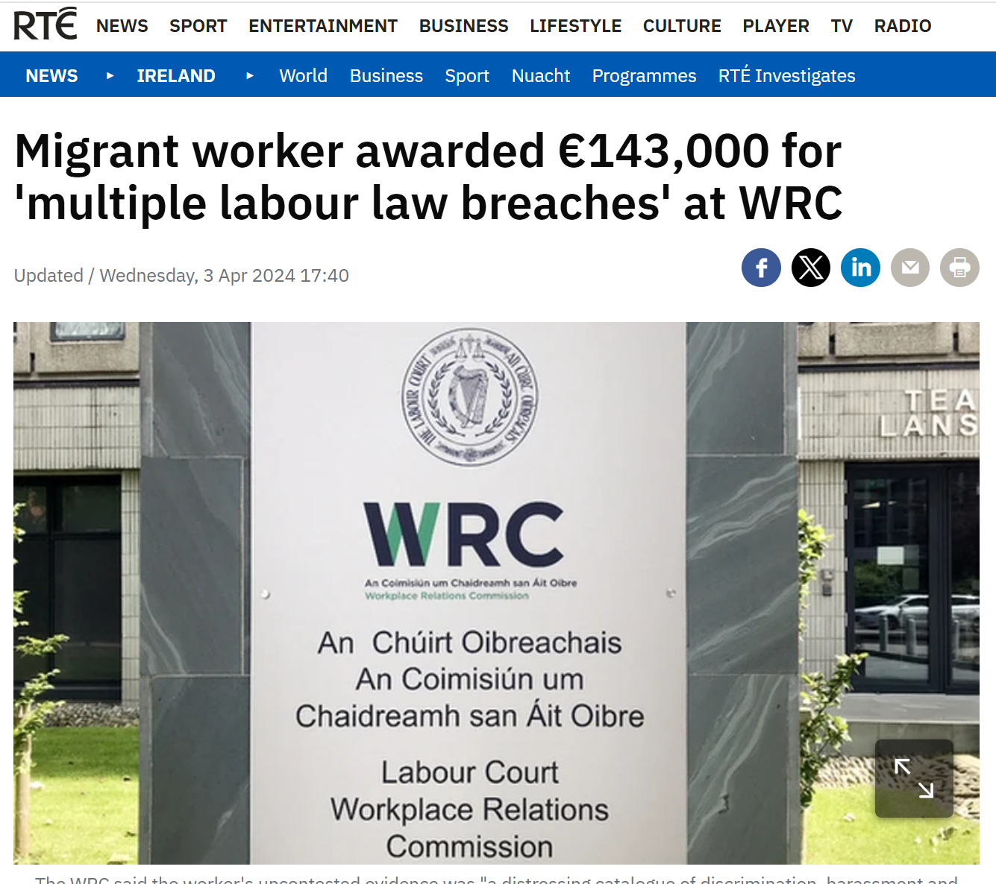
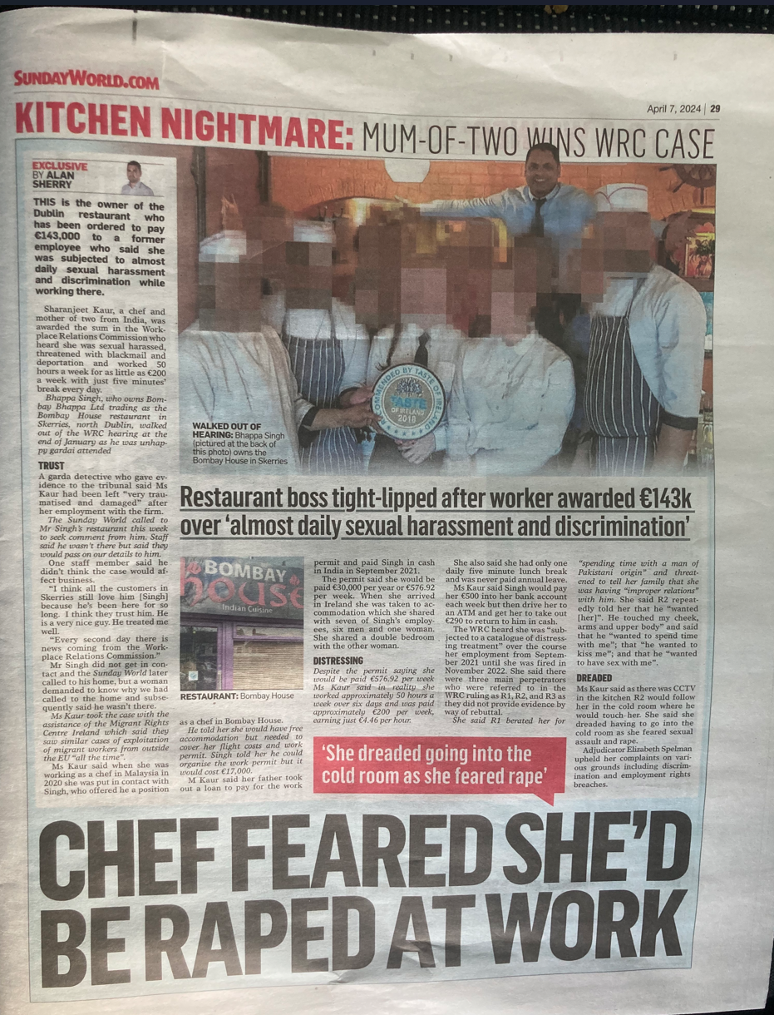

Slide 35
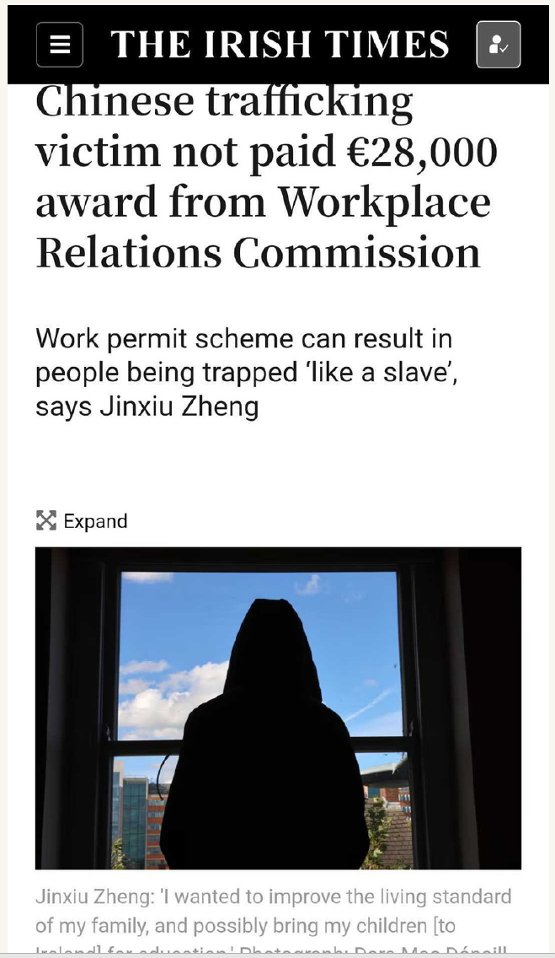
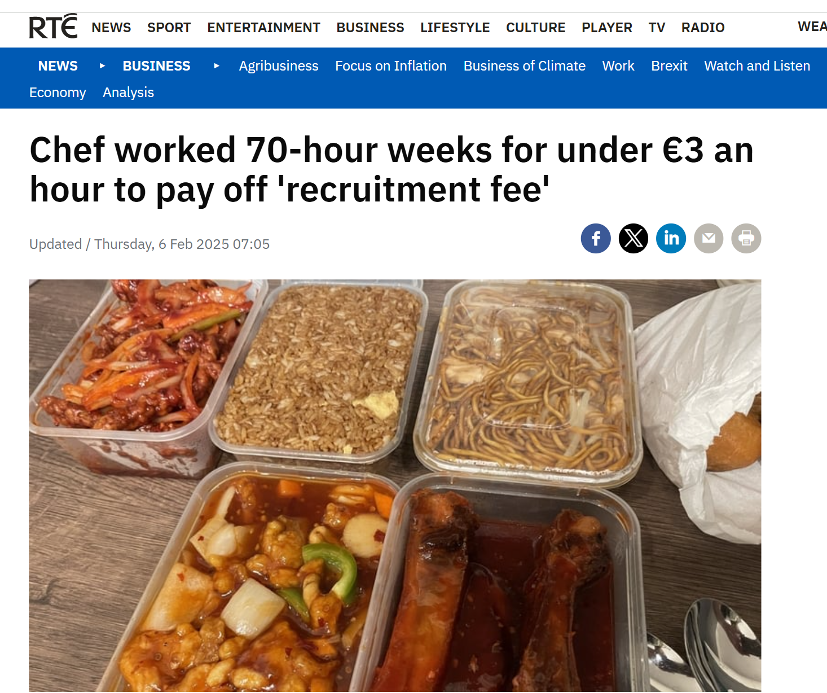

Slide 36
Severe Labour exploitation
Reporting a concern
Contact Gardaí
Contact MRCI at info@mrci.ie
Notes:
Potential signs
-Sleep where they work
-Limited outside contact
-Long hours, few days off if any
Comes down to the person wanting to come forward and do something.
Garda Line: 1800 666 111

Slide 37







For Regular Updates
Follow us on Social Media
www.mrci.ie

Slide 38
THANK YOU

