Slide 1


Reactivation Application for Employment Permit Holders: Information Session
Presented by:
Daniel Korolev, MRCI
03/09/2025

Slide 2


Who is MRCI?
MRCI is a national organisation working to advance the rights of migrant workers and their families at risk of exploitation, social exclusion and discrimination.
MRCI handle up to 3,500 cases a year through our national Information and Support Centre, which is a free and confidential service. We provide information, support, and advocacy on a wide variety of issues, including immigration rights and employment rights, via face-to-face, telephone, email and ongoing public awareness campaigns.
MRCI has been taking a stand with migrants to tackle the root causes of inequality since 2001.

Slide 3
Disclaimer
These materials have been prepared by the Migrant Rights Centre Ireland (MRCI) for information purposes only with no guarantee as to accuracy or applicability to a particular set of circumstances. The materials are not intended and should not be considered to be legal advice. The information given may change from time to time and may be out of date. The Migrant Rights Centre Ireland disclaims any legal responsibility for the content or the accuracy of the information provided. MRCI is not a practicing law centre.

Slide 4
Agenda
01.
What is Reactivation?
05.
Step 2: Applying to the DETE
02.
The Benefits of Reactivation
06.
Important Information
03.
The Eligibility Criteria
07.
Q&A
04.
Step 1: Applying to Immigration

Slide 5
01. What is Reactivation?
“The purpose of the scheme operated by DETE is to provide to a non-EEA national worker who held or holds an Employment Permit a pathway to legal re-employment where they have fallen out of employment and immigration permission through no fault of their own, or who has been exploited or poorly treated by their employer.”
Reactivation Employment Permit (REP) is its own type of separate employment permit with the DETE.
Applying is a 2-step process:
1. Firstly, the applicant must apply to the Department of Justice to receive a permission letter to apply for a REP.
2. Secondly, with this permission letter the applicant can apply for an REP with the DETE.

Slide 6
02. The Benefits of a REP
A REP application has a number of benefits, particularly over a General Employment Permit.
    A Labour Market Needs Test is not required for a Reactivation Permit.
    No minimum salary requirement, as long as pay is at least minimum wage (€13.50 per hour as of January 2025).
    Can apply for permission with immigration (1st step) even if applicant still has employment permit and is still working.
    It is a potential way out of an exploitative workplace and working conditions.
    Can apply even if immigration permission has expired (e.g. if work permit is not renewed).
    REP can be issued for any jobs in any sectors (except certain domestic carer jobs)

Slide 7
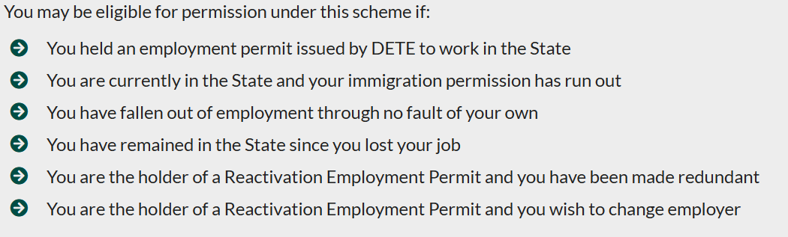
03. The Eligibility Criteria
Above eligibility criteria taken from Department of Justice website. To add, if you have been mistreated or exploited at the workplace you may also be eligible.
This can be the case even if your permit is still active and you are still working.

Slide 8
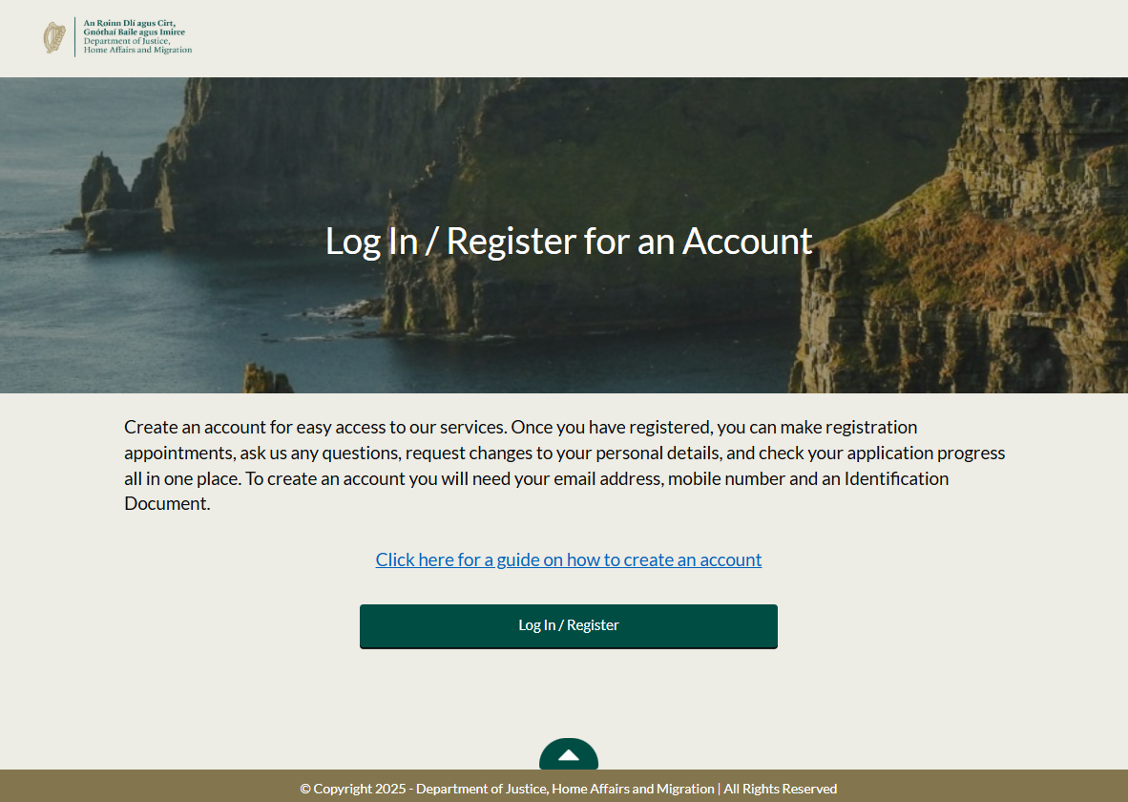
04. Step 1: Applying to Immigration
Before the Reactivation Employment Permit can be applied for, the applicant must apply to Immigration to receive a 6-month permission letter.
This application must be submitted through the Customer Service Immigration Portal.
For more information on how to make an account, please see our Immigration Portal Info Webinar and the DOJ guide on using the portal, in the Useful Links slide.

Slide 9
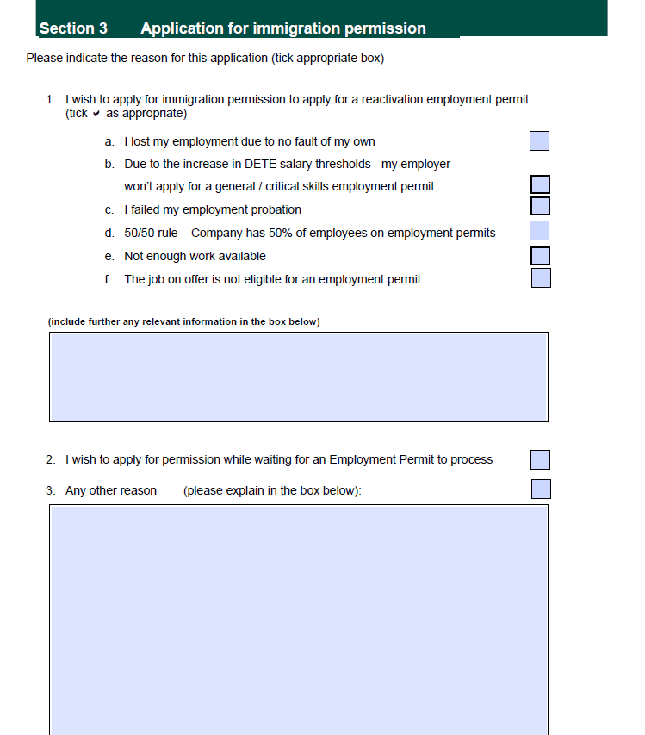
04. Step 1: Applying to Immigration
Fill out the Reactivation Application form, which is split into 3 sections.
Section 1 and 2 answers questions about basic personal info and immigration status in Ireland.
Section 3 asks for information as to why the applicant is applying. Tick the relevant check box (can tick more than one). Provide information on why the application is being made in additional information boxes.
Section 4 lists required documentation. Submit a copy of IRP card as well as the listed documents.

Slide 10
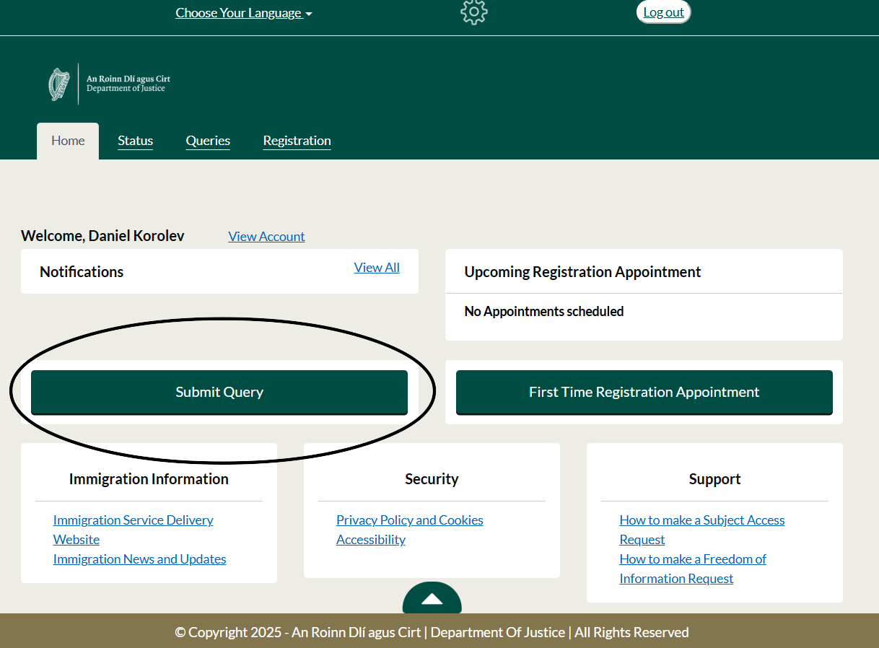

04. Step 1: Applying to Immigration
Submitting Application Through the Portal

Slide 11
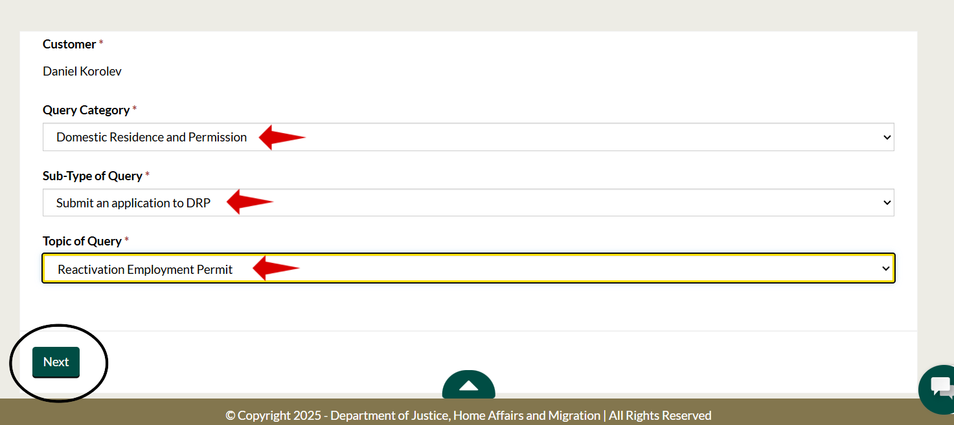

04. Step 1: Applying to Immigration
Submitting Application Through the Portal

Slide 12
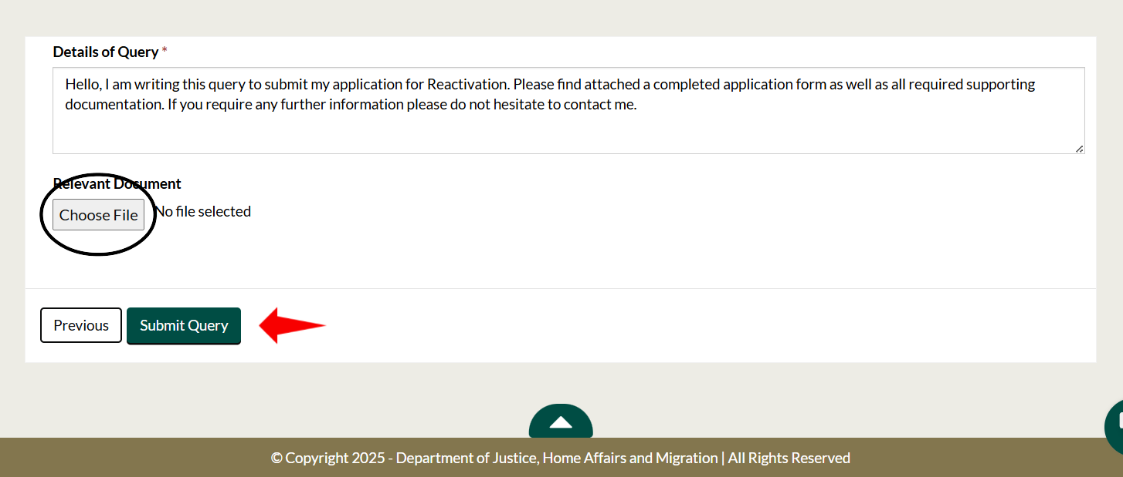

04. Step 1: Applying to Immigration
Submitting Application Through the Portal

Slide 13
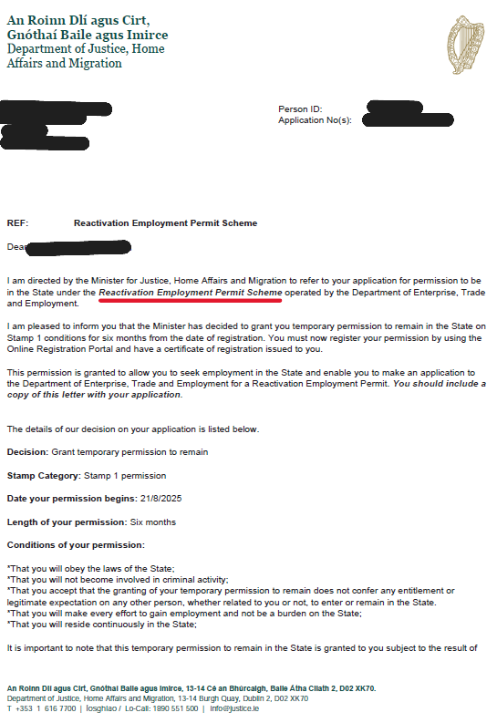
04. Step 1: Applying to Immigration
After application is submitted, applicant will receive an acknowledgement letter.
If more information is required, immigration will make contact either through the portal or by email.
If application is successful, a 6-month Stamp 1 permission letter will be issued (see image), allowing applicant to seek employment to apply for a Reactivation Employment Permit. Can use this letter to renew IRP card.
To note, currently processing times can be a number of months. Submit a query through Immigration Portal to ask for an update.

Slide 14
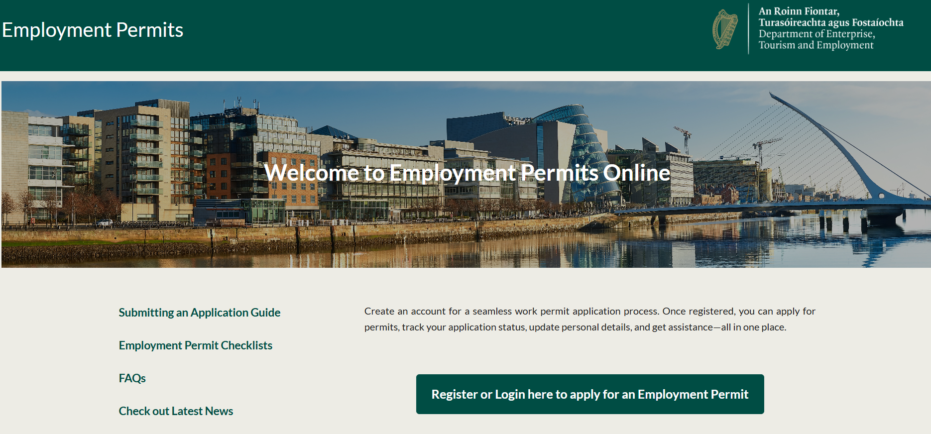
05. Step 2: Applying to the DETE
Once the applicant has received the letter from Immigration and has an employer a REP can be applied for.
All permit applications are operated through the DETE portal since April 2025.
Make an account (both the employee and employer must) here: https://employmentpermits.enterprise.gov.ie
If there are issues with creating an account, email epos@enterprise.gov.ie.

Slide 15
05. Step 2: Applying to the DETE
Important to note, that both the employee and employer must have an account on the DETE Portal to apply for a permit.
Either the employer or employee can start the process of applying for the permit, but both parties need to be involved, answer the relevant questions and attach supporting documents.
DETE Portal guide linked in Useful Slides link, follow the guide to apply for the permit.

Slide 16
05. Step 2: Applying to the DETE
Make sure that Reactivation Permit is chosen, not General Employment Permit or Critical Skills.
Permission letter from Immigration must be attached with the application.
Payment of €1000 must be made for a 2-year permit, paid directly either by employer or employee. If employer makes the payment they cannot deduct this from salary at a later point.
Check DETE processing times page for updates on how long this will take (Reactivation permit falls under new permit applications)

Slide 17
06. Important Information
Recently, there has been regular requests from Immigration for letters from employers/job offer letters. This is not a requirement. Please contact MRCI if this request is made.
The permission letter from Immigration must specify the word ‘Reactivation’. If not, the wrong letter has been received.
In required supporting documents, request for ‘Letter from the Department of Enterprise Tourism and Employment or your employer detailing the reason for this application.’ A termination letter or any communication with employer explaining the situation can be accepted. Proof of permit cancellation from the DETE can also be used.
The Change of Employer Scheme does not apply to those on the Reactivation Permit. If a REP holder wishes to change employer they must apply for Reactivation again.
Reactivation Permit required for 5 years to apply for Stamp 4, similar to General Employment Permit.

Slide 18
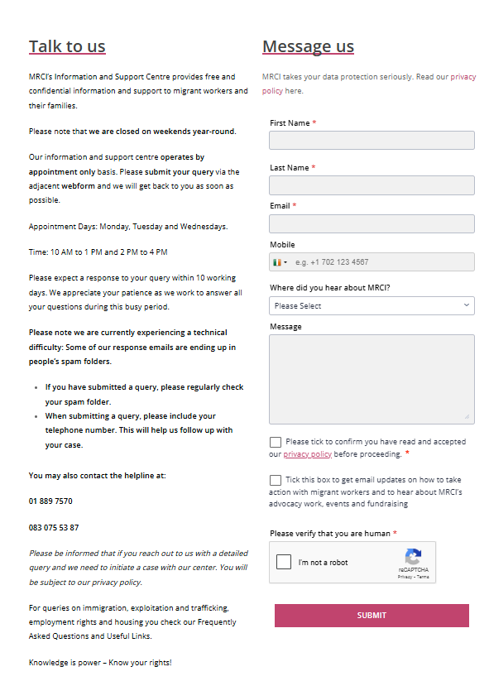
Information and Support Centre
www.mrci.ie/contact-us
Our Information and Support Centre is currently running on an appointment basis.
If you would like to speak to us, the best way to get in touch is by sending us a message via the Contact Page on our website!

Slide 19
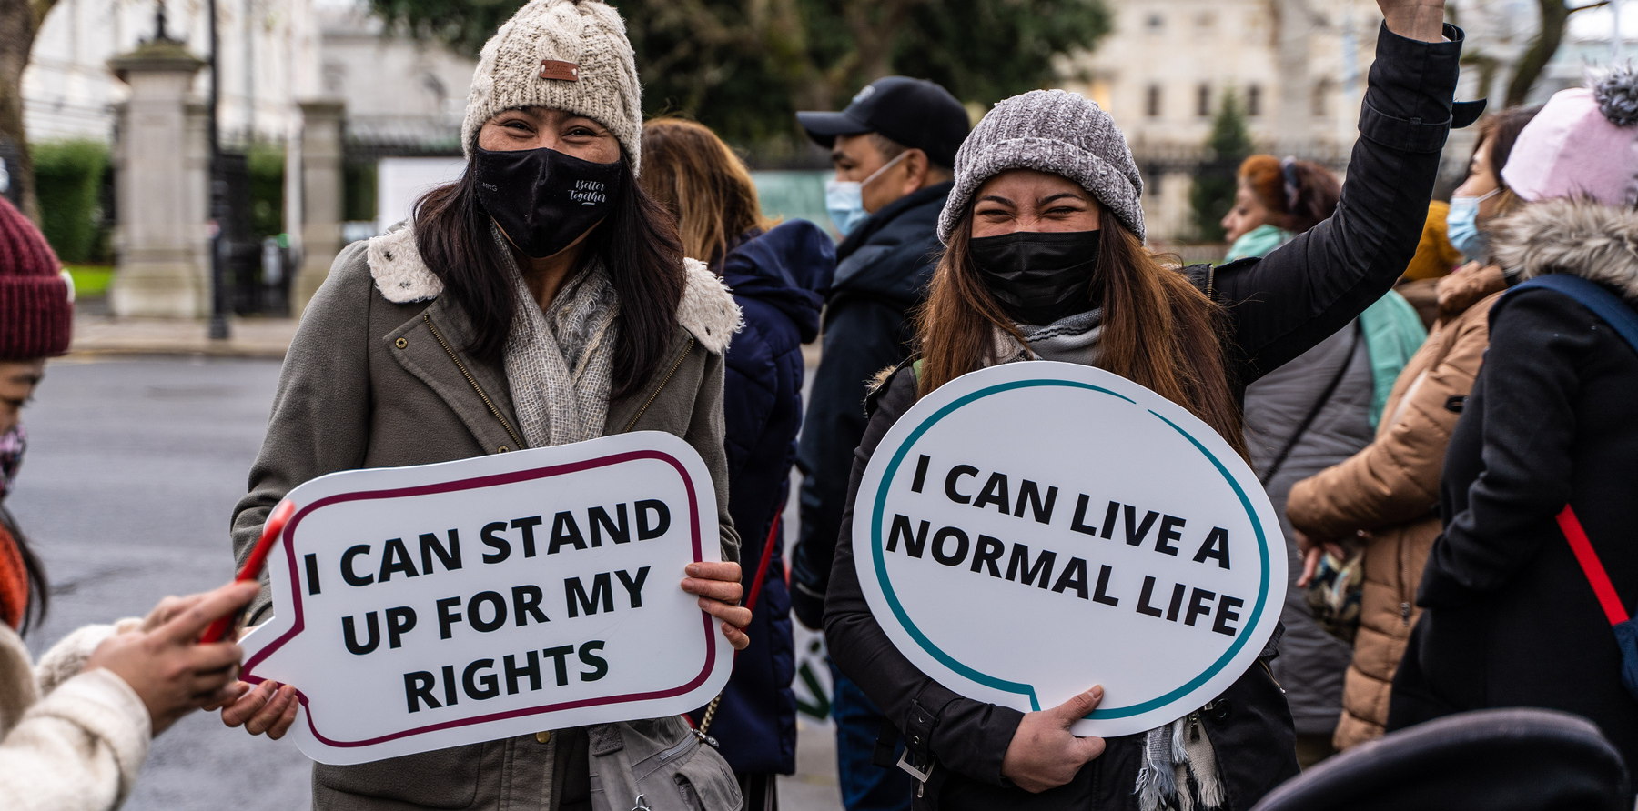

Join our campaigns
www.mrci.ie/our-work
Get Involved
Sign up as a supporter
www.mrci.ie/#signup
Donate
www.mrci.ie/donate
Join Us Today!

Slide 20







For Regular Updates
Follow us on Social Media
Website
www.mrci.ie

Slide 21
THANK YOU

Slide 22



Q&A Session
Please ask any questions.

Slide 23
More Info / links
Related Links:
  DOJ Webpage on Reactivation (includes a link to the application form: https://www.irishimmigration.ie/my-situation-has-changed-since-i-arrived-in-ireland/reactivation-employment-permit-scheme/
  Immigration Customer Service Portal: https://portal.irishimmigration.ie/en/
  MRCI Webinar on using Customer Service Portal: https://www.youtube.com/watch?v=Z8XN7PyXhUU
  DETE Portal (for permit applications): https://employmentpermits.enterprise.gov.ie/
  DETE Portal Guide: https://enterprise.gov.ie/en/what-we-do/workplace-and-skills/employment-permits/latest-updates/new-eps/new-employment-permits-system.html
  DETE permit processing times: https://enterprise.gov.ie/en/what-we-do/workplace-and-skills/employment-permits/current-application-processing-dates/
  Contact MRCI: https://www.mrci.ie/contact-us/

