Slide 1


Webinar-
Change of Employer
Presented by::
Daniel Korolev, MRCI
13/08/2025

Slide 2


Who is MRCI?
MRCI is a national organisation working to advance the rights of migrant workers and their families at risk of exploitation, social exclusion and discrimination.
MRCI handle up to 3,500 cases a year through our national Information and Support Centre, which is a free and confidential service. We provide information, support, and advocacy on a wide variety of issues, including immigration rights and employment rights, via face-to-face, telephone, email and ongoing public awareness campaigns.
MRCI has been taking a stand with migrants to tackle the root causes of inequality since 2001.

Slide 3
Disclaimer
These materials have been prepared by the Migrant Rights Centre Ireland (MRCI) for information purposes only with no guarantee as to accuracy or applicability to a particular set of circumstances. The materials are not intended and should not be considered to be legal advice. The information given may change from time to time and may be out of date. The Migrant Rights Centre Ireland disclaims any legal responsibility for the content or the accuracy of the information provided. MRCI is not a practicing law centre.

Slide 4
Agenda
01.
What is Change of Employer?
04.
Benefits of Change of Employer
02.
What are the eligibility criteria?
05.
How to apply using the new DETE portal
03.
What is a SOC code- Standard Occupational Classification?
06.
Q&A

Slide 5

01. What is Change of Employer?
Employment Permit Act 2024 introduced the Change of Employer provision in September 2024.
It allows employment permit holders to change employers by applying to the Department of Enterprise, Tourism, and Employment (DETE) after a period of 9 months has passed since commencing their first employment permit in the State.
Previously work permit holders could only apply for a new permit after 12 months, this allows the permit holder to retain their existing permit but still change employer.

Slide 6
02. What are the eligibility criteria?
The Applicant Must:
Be currently holding either General or Critical Skills Employment Permit.
Have had 9 months elapsed since their FIRST employment permit in the state, however…
In exceptional cases of exploitation or major changes to your employment situation you may apply, e.g. the hours that you work are being significantly changed.
Have a permit still valid and have at least 2 months validity remaining.
The DETE has confirmed that you must still be working when applying. Do not resign before completing the Change of Employer process.
The new role must be within the same type of employment – same SOC Code.

Slide 7
03. What is a SOC code?
SOC code refers to the Standard Occupational Classification (SOC).
Assigns all jobs a four-digit code based on skills and qualifications needed for the job.
General Employer Permit holders can apply to change employers within the type of employment that they are already in.
Essentially must work in the same role, minimal scope for change.

Slide 8
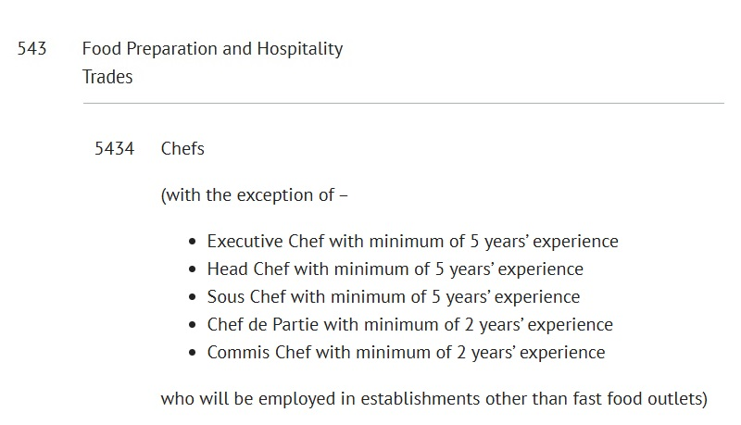
03. What is a SOC code?
Example of General Employment Permit SOC Code

Slide 9
03. What is a SOC code?
Important Note for Health Care/Home Care Assistants:
6141- Nursing auxiliaries and assistants
RELATED JOB TITLES: Auxiliary nurse, Health care assistant (hospital service), Health care support worker, Nursing assistant, Nursing auxiliary.
6145- Care workers and home carers
RELATED JOB TITLES: Care assistant, Care worker, Carer, Home care assistant, Home carer, Support worker (nursing home)
Cannot change between these SOC codes, however HCA’s in hospitals can change to HCA’s in nursing homes.

Slide 10
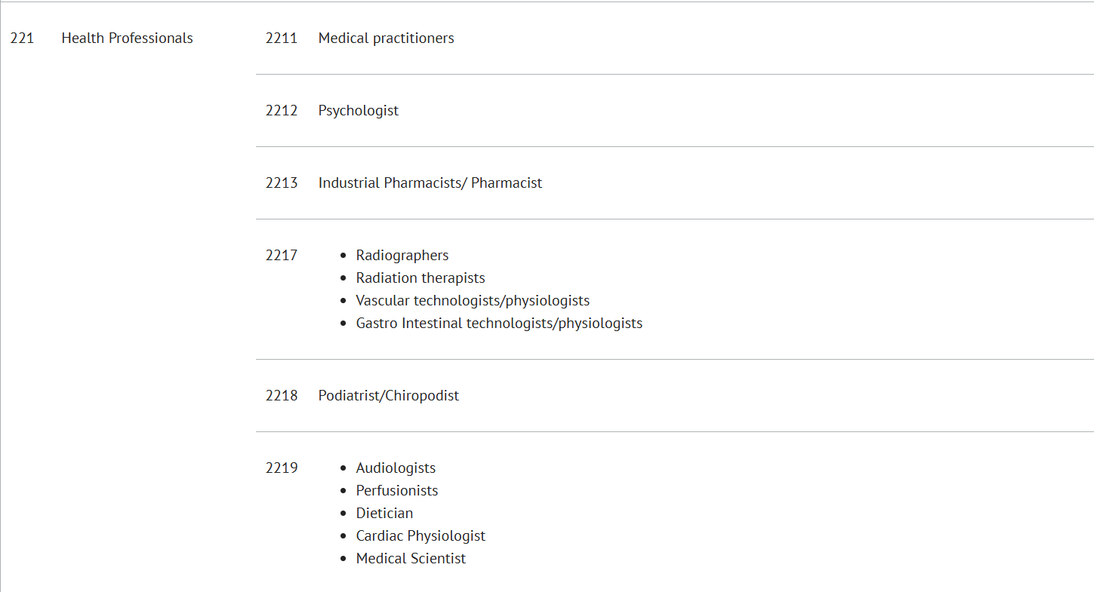
03. What is a SOC code?
Changing Employer on a Critical Skills Permit:
CSEP holders can change to an employer across a broader category of employment, for example, different engineering roles ( identified by its 3-digit SOC code).
For Example Soc code 211- Natural and Social Science Professionals. Chemical scientist, medical laboratory scientist, biological scientist and biochemist, physical scientist in manufacturing etc.

Slide 11
04. Benefits of Change of Employer
No reason needed to change employer after 9 months.
Potential way out of exploitative workplace, even before the 9 months elapses.
No Labour Market Needs Test (LMNT) is required.
No fee for this process and relatively short processing times.
Can use Change of Employer up to 3 times.
No documentation or information is needed from the old employer. Again, no need to resign in advance!

Slide 12
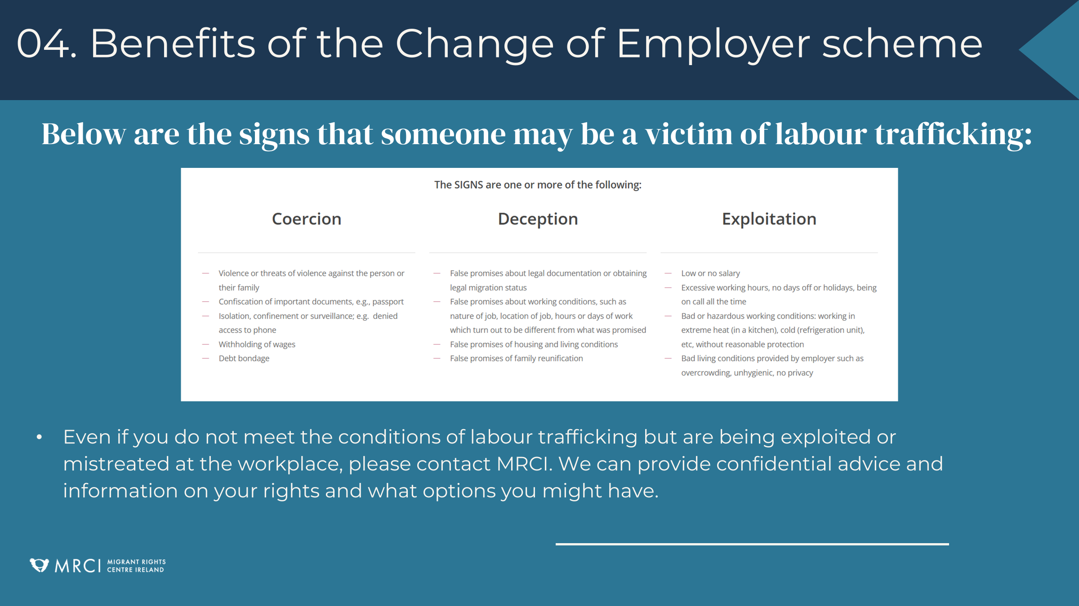

Slide 13
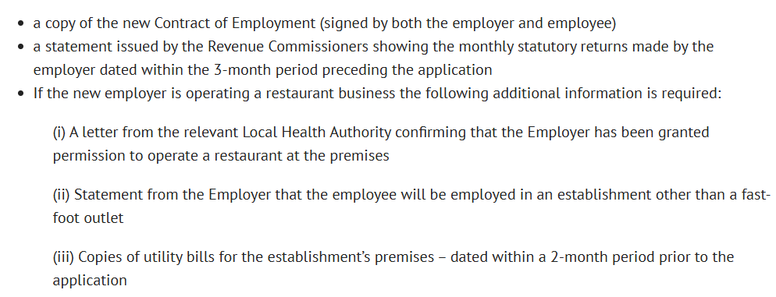
05. How to apply using the new DETE portal
What an Applicant Needs to Apply:
A new employer is required, who needs to create an account on the DETE Portal as well.
The following documents are required:

Slide 14

05. How to apply using the new DETE portal
Change of Employer is operated through the DETE portal since April 2025.
Make an account (both the employee and employer must) here: https://employmentpermits.enterprise.gov.ie
If there are issues with creating an account, email epos@enterprise.gov.ie

Slide 15
05. How to apply using the new DETE portal
Steps to Apply:
Both the Employer and the Employee must create an account on the DETE portal.
The DETE recommends the employer begins the process. Employer needs to press the ‘Transfer Permit’ button, found above the ‘Permits’ grid on the home page.
2(a). If the employee begins the process, they must press the ‘Action’ button next to their active permit. A ‘Transfer’ button will be available at this point.
Both the employer and the employee will need to answer all required questions and attach supporting documents.
Submit the application, wait until the permit has been changed. An employee legally cannot start working with the new employer before this.
Employee must start with new employer within one month of changed permit being issued.

Slide 16
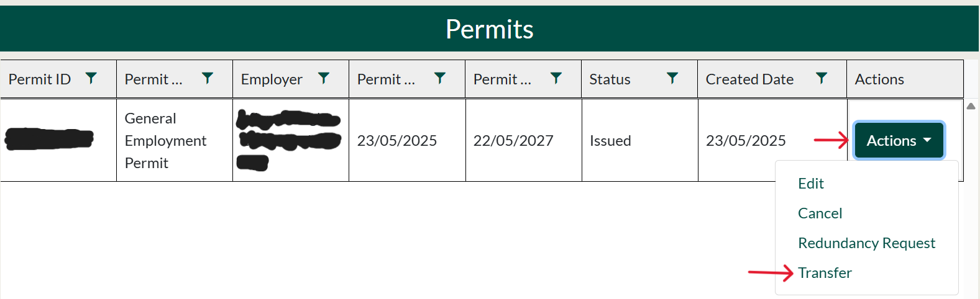

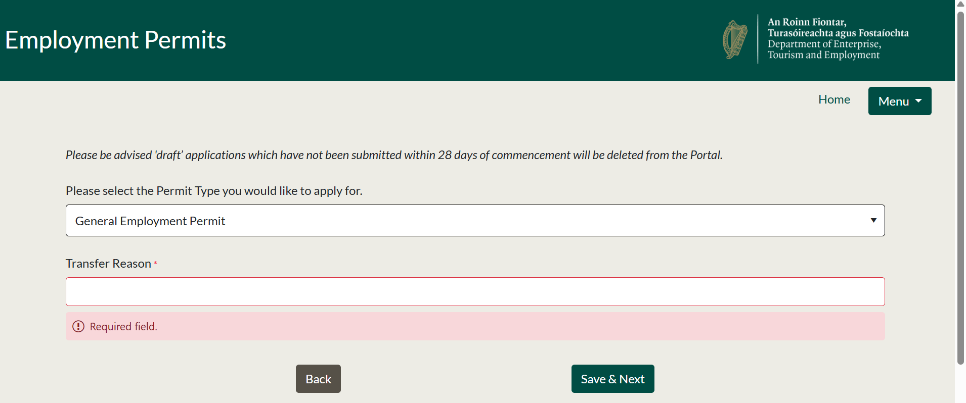

05. How to apply using the new DETE portal
For Employee to Begin Process:

Slide 17
05. How to apply using the new DETE portal
For Employer to Begin Process:

Slide 18
More Info / links
Related Links:
DETE Portal: https://employmentpermits.enterprise.gov.ie
DETE Info on Change of Employer: https://enterprise.gov.ie/en/what-we-do/workplace-and-skills/employment-permits/changing-employer/
SOC Code List (Please note, this sheet of codes is very confusing and not user-friendly): https://webarchive.nationalarchives.gov.uk/ukgwa/20160108044151/http://www.ons.gov.uk/ons/guide-method/classifications/current-standard-classifications/soc2010/soc2010-volume-2-the-structure-and-index/index.html
Critical Skills Job List (with SOC Codes): https://enterprise.gov.ie/en/what-we-do/workplace-and-skills/employment-permits/employment-permit-eligibility/highly-skilled-eligible-occupations-list/
MRCI Contact Us Webform: https://www.mrci.ie/contact-us/

Slide 19
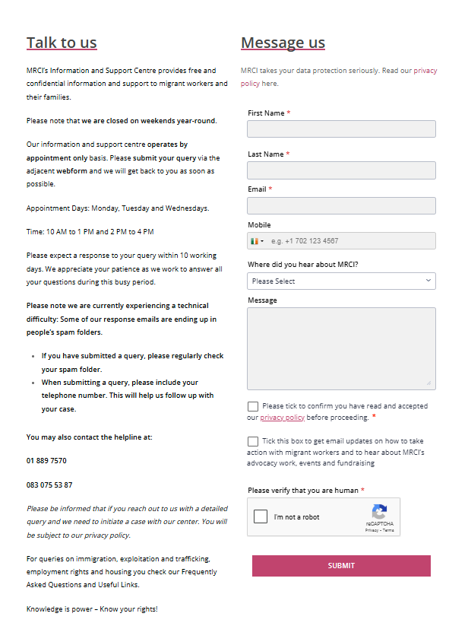
Information and Support Centre
www.mrci.ie/contact-us
Our Information and Support Centre is currently running on an appointment basis.
If you would like to speak to us, the best way to get in touch is by sending us a message via the Contact Page on our website!

Slide 20







For Regular Updates
Follow us on Social Media
Website
www.mrci.ie

Slide 21


Join our campaigns
www.mrci.ie/our-work
Get Involved
Sign up as a supporter
www.mrci.ie/#signup
Donate
www.mrci.ie/donate
Join Us Today!

Slide 22
THANK YOU

