Slide 1
Using The New Online
Immigration Self-Service Portal
26/02/2025
Presented by:
Daniel Korolev, MRCI
Notes:
hello

Slide 2
Who is MRCI?
MRCI is a national organisation working to advance the rights of migrant workers and their families at risk of exploitation, social exclusion and discrimination.
MRCI handle up to 3,500 cases a year through our national Information and Support Centre, which is a free and confidential service. We provide information, support, and advocacy on a wide variety of issues, including immigration rights and employment rights, via face-to-face, telephone, email and ongoing public awareness campaigns.
MRCI has been taking a stand with migrants to tackle the root causes of inequality since 2001.

Slide 3
Disclaimer
These materials have been prepared by the Migrant Rights Centre Ireland (MRCI) for information purposes only with no guarantee as to accuracy or applicability to a particular set of circumstances. The materials are not intended and should not be considered to be legal advice. The information given may change from time to time and may be out of date. The Migrant Rights Centre Ireland disclaims any legal responsibility for the content or the accuracy of the information provided. MRCI is not a practicing law centre.

Slide 4
Agenda
1.
What is the Immigration Customer Service Portal? Why is it important?
5.
Check the status of an application
2.
How to make an account/ID-PAL Document verification
6.
Useful Tips and Known Issues
3.
Making a first-time immigration registration appointment
4.
How to submit an application or query

Slide 5
What is the Immigration Customer Service Portal? Why is it important?

Slide 6
What is the Immigration Customer Service Portal? Why is it important?
Allows Users To:
Book a first-time registration appointment (no more call option available).
Submit applications to the Department of Justice (i.e. Reactivation, Change of Status) .
Check the status of existing applications.
Submit queries and communicate with all immigration divisions(replaces individual emails for each).
ISD/INIS website still used to renew IRP cards, apply for citizenship and others.

Slide 7
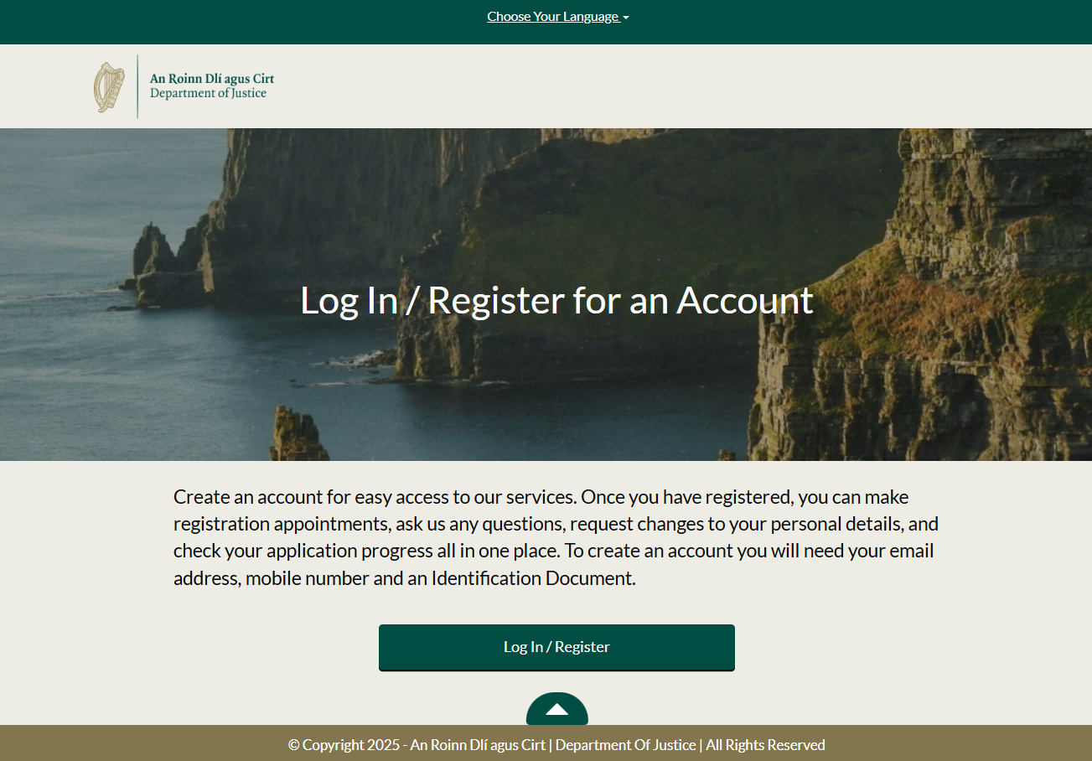
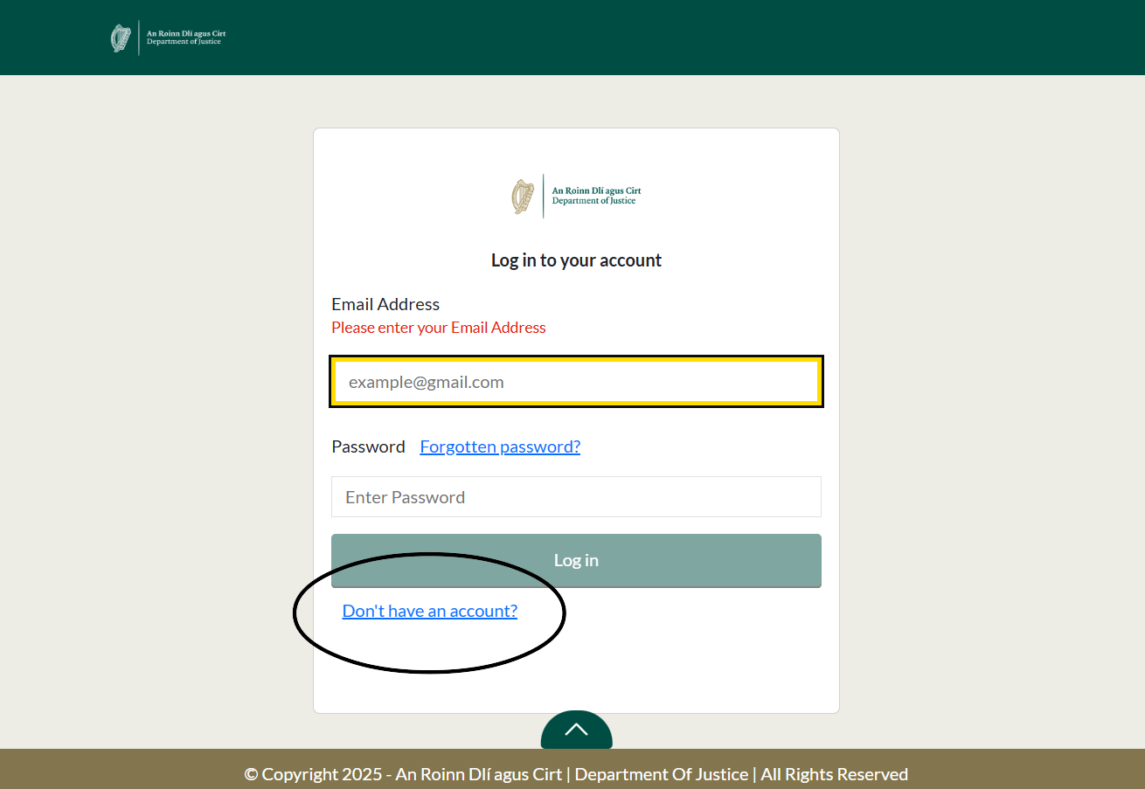
2. How To Make An Account/ID-PAL Verification
Open the Customer Service Portal: https://portal.irishimmigration.ie/en/
Click ‘Log In/Register’
Click ‘Don’t have an account?’ at the bottom (see photo 2)
Proceed to follow the next steps:
Verify Email Address
Personal Details
Nationality
Create Password
Verify Mobile
Make sure all details match identity document!

Slide 8
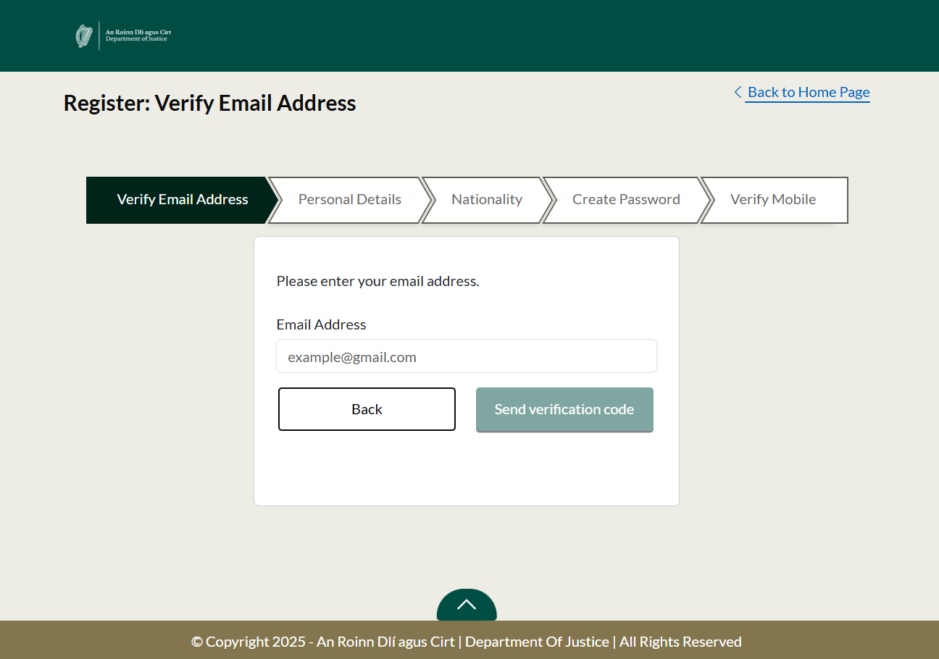

Slide 9
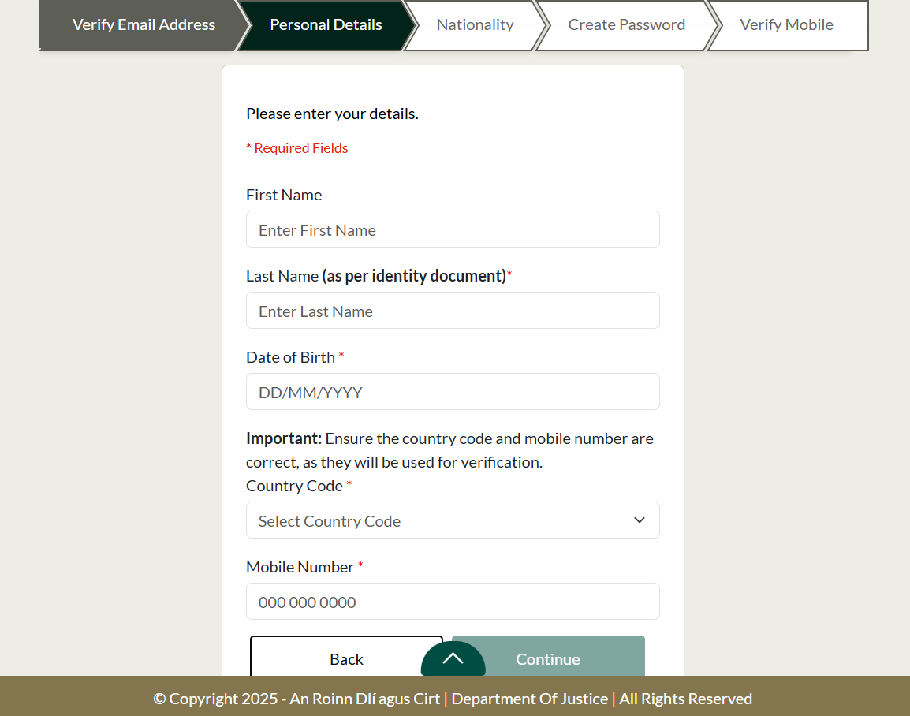

Slide 10
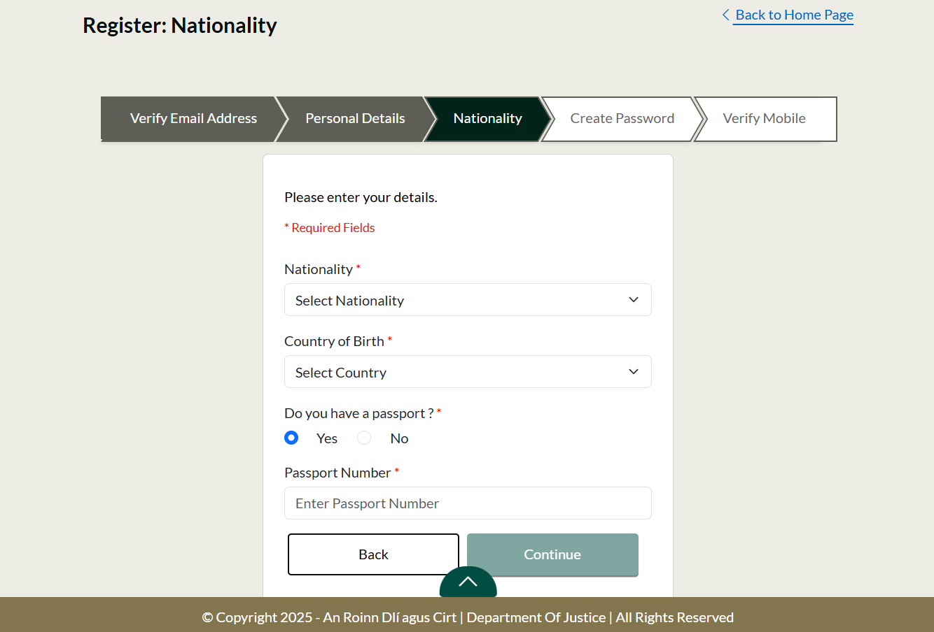

Slide 11
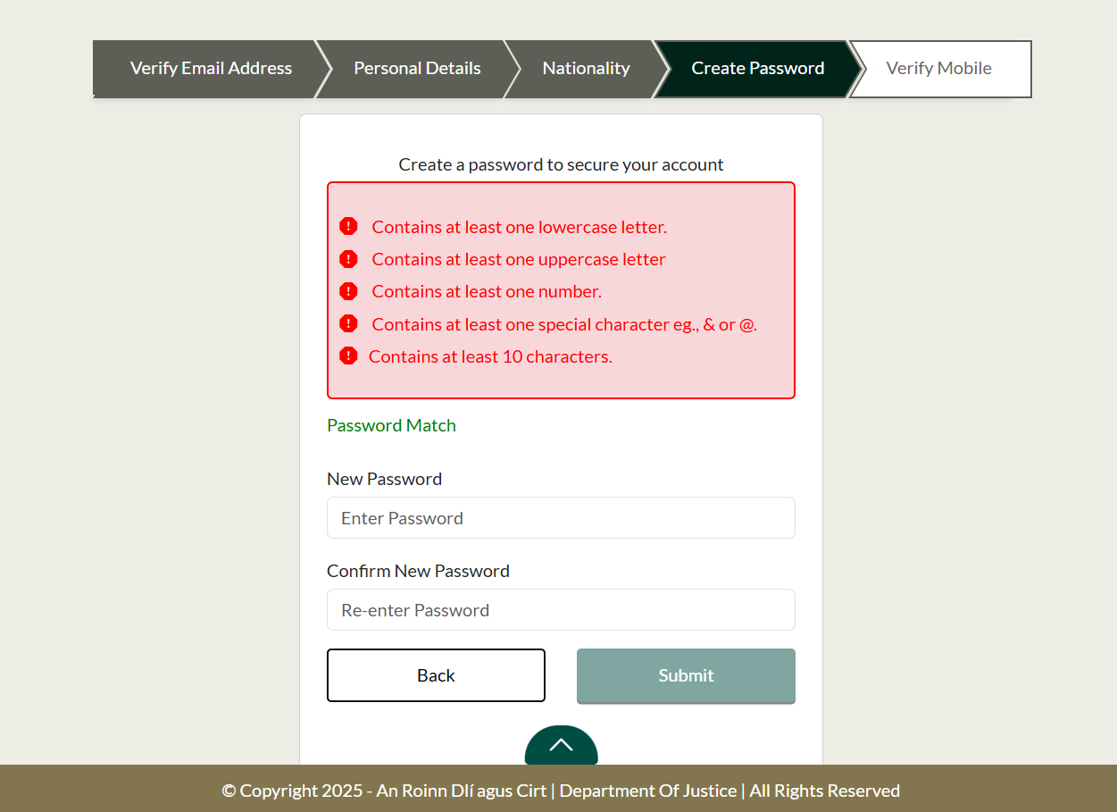

Slide 12
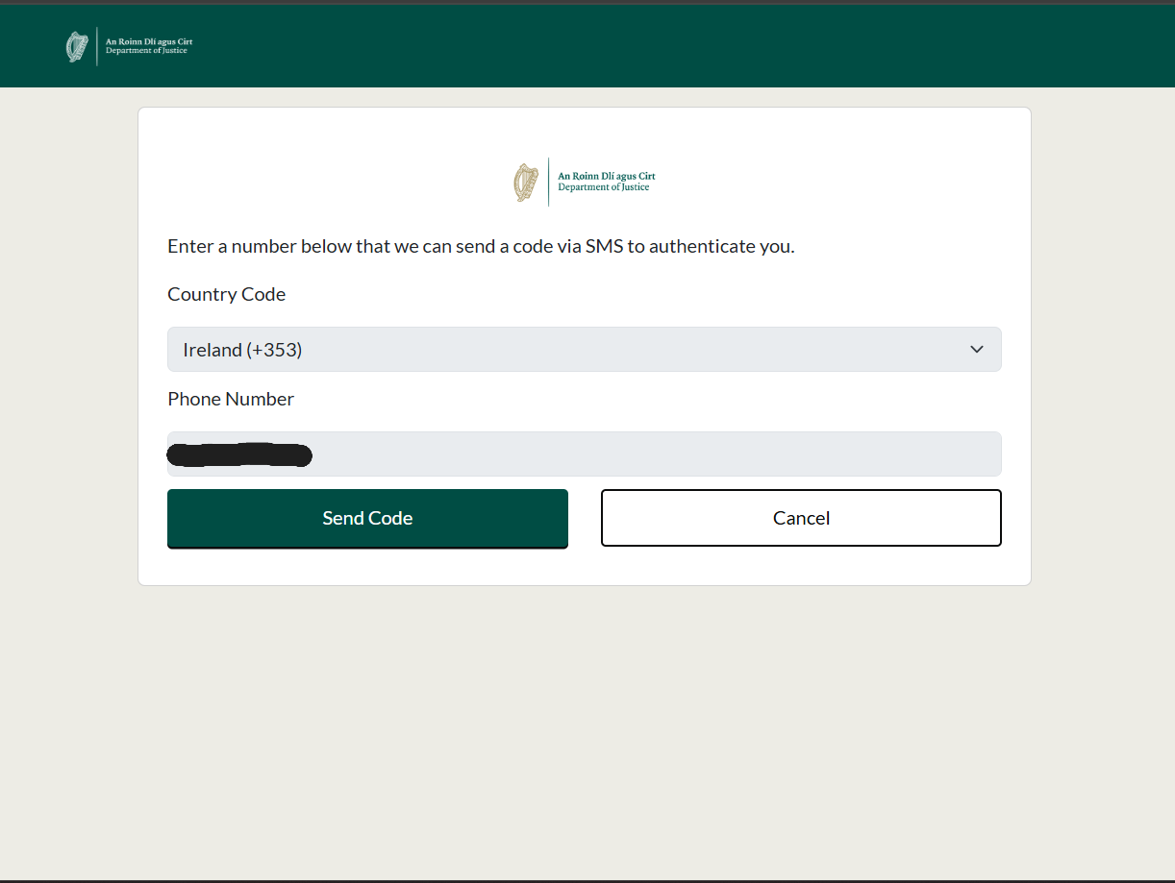

Slide 13
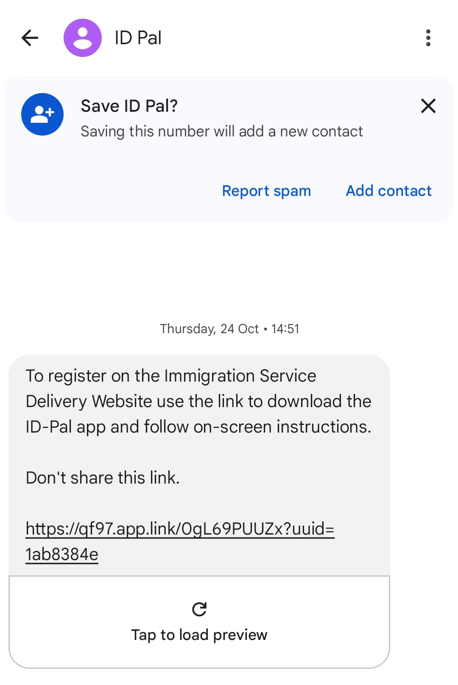
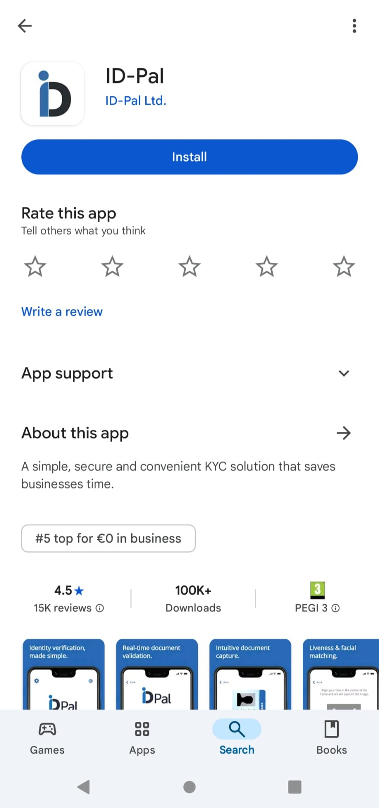
2. How To Make An Account/ID-PAL Verification
To create an account an identity document must be verified.
Currently accepted ID documents are passports and driving licenses.
You will receive a text message (Photo 1) to download the ID-PAL app (Photo 2) and upload your document to the Department of Justice.
Open the app and press ‘Create a Submission’.
Photocopies or scans are not accepted, must be original documents.

Slide 14
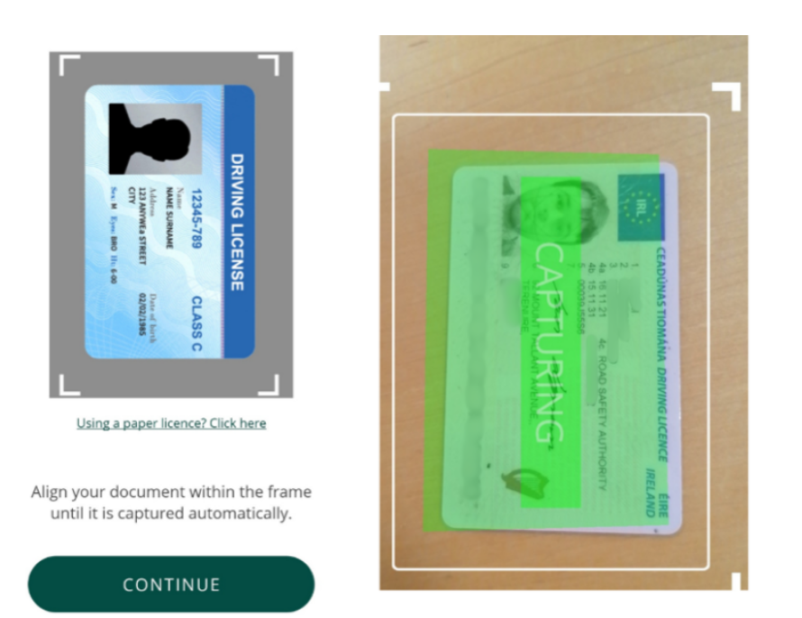
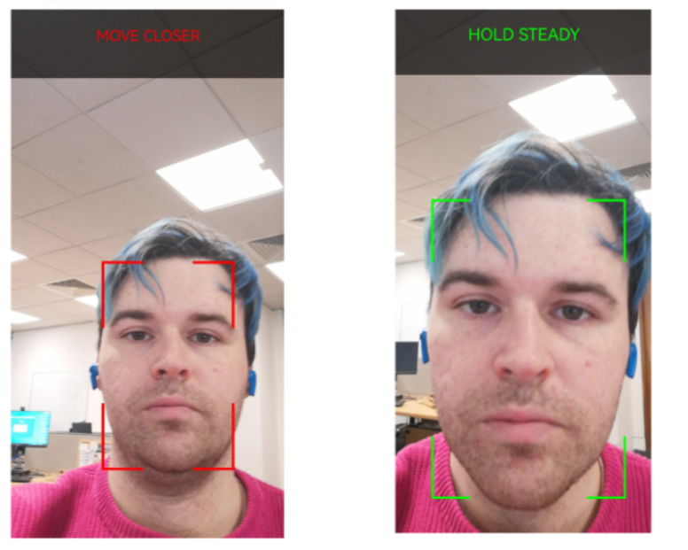
2. How To Make An Account/ID-PAL Verification
Choose document to verify and scan as shown in Photo 1.
Scan face as shown in Photo 2.
Photos taken from ‘Customer Service Portal – A guide to using the online self-service portal’: https://www.irishimmigration.ie/customer-service-portal-a-guide-to-using-the-online-self-service-portal/#book-first-time-appointment

Slide 15
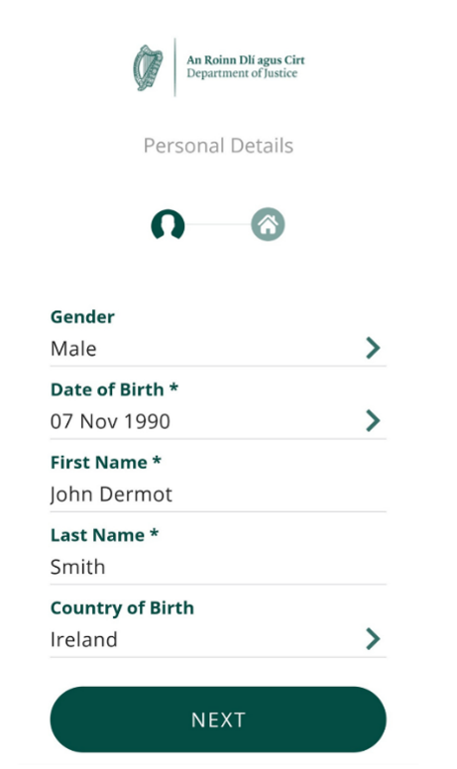
02. How To Make An Account/ID-PAL Verification
Insert personal information as shown in photo.
Very important that this information matches the identity document used.
If a failed message is received, create a new submission and try again.
Wait for a confirmation text that identity has been verified, go back to portal website and log in.
Photo taken from ‘Customer Service Portal – A guide to using the online self-service portal’: https://www.irishimmigration.ie/customer-service-portal-a-guide-to-using-the-online-self-service-portal/#book-first-time-appointment

Slide 16
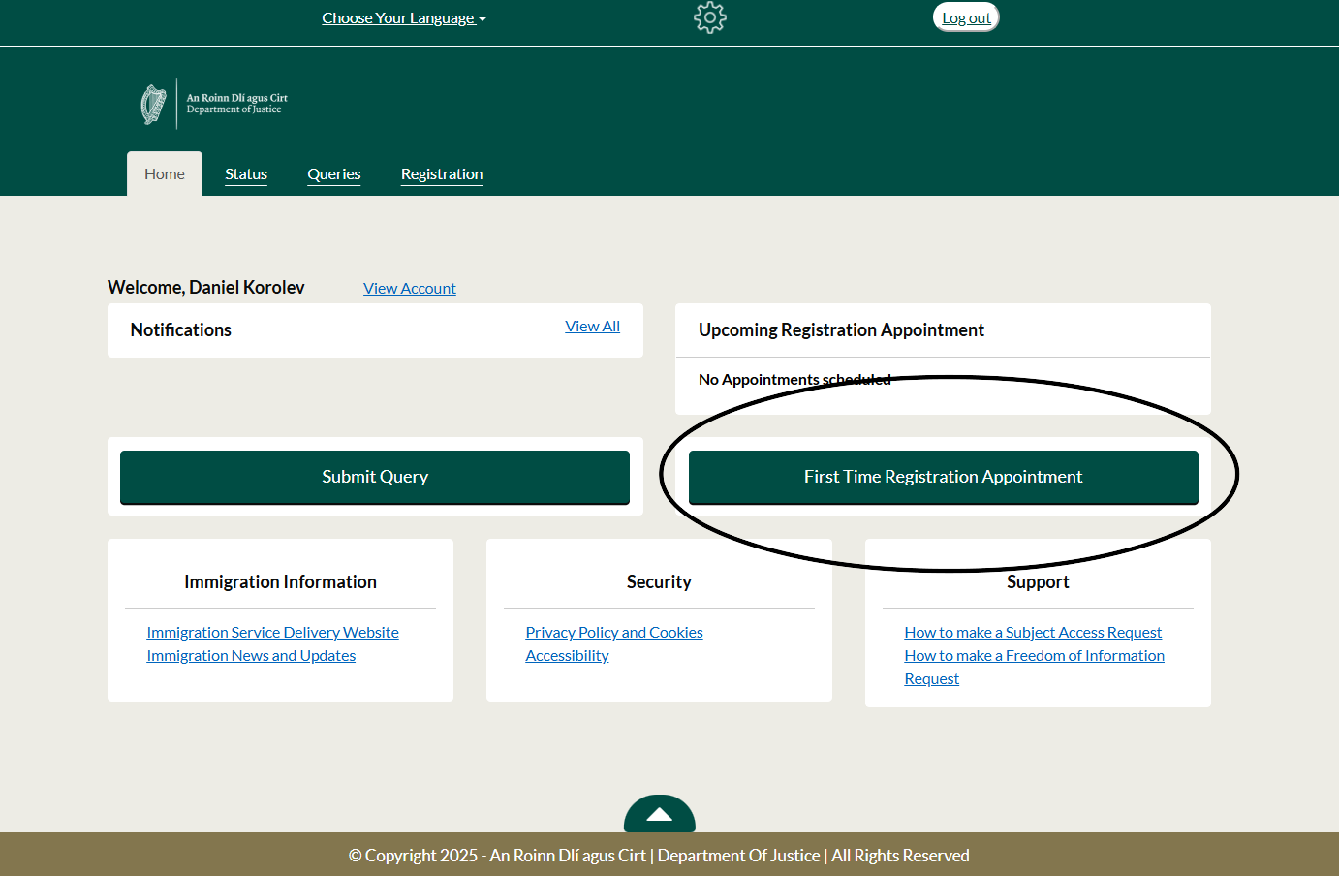
3. Making A First-Time Registration Appointment
If this is your first IRP card registration or your permission is expired for more than 6 months you must make a first-time registration appointment.
Regardless of county, all appointments now in Burgh Quay Immigration office in Dublin.
Note there is an over 2-month backlog, book your appointment as early as you can.
Option available to cancel or reschedule the appointment if required.
You will receive an email with appointment details.

Slide 17
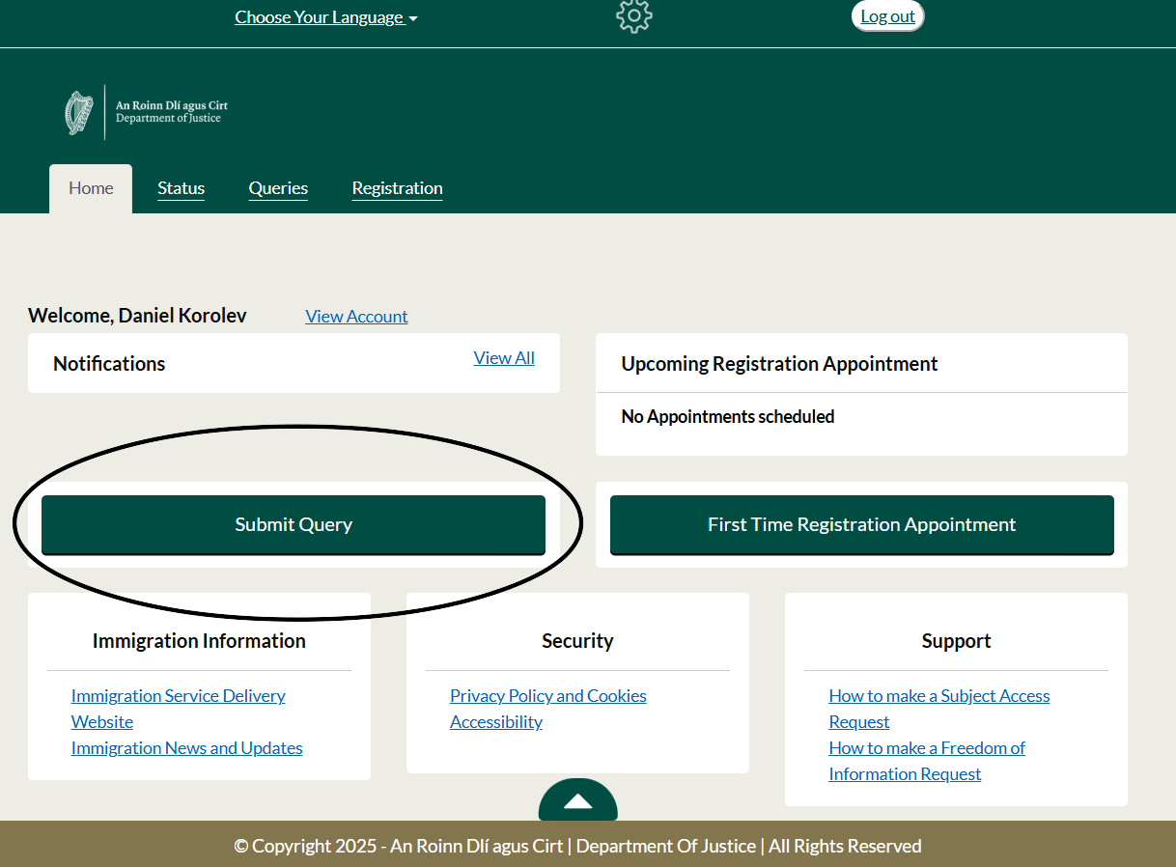
4. How To Submit An Application/ Query
If you need to contact any immigration division the portal can now be used (i.e Citizenship, Domestic Residence and Permission, EUTR, IRP Registration).
Certain applications now submitted through the portal.
Select your query category, write a message, attach any necessary documentation and submit.

Slide 18
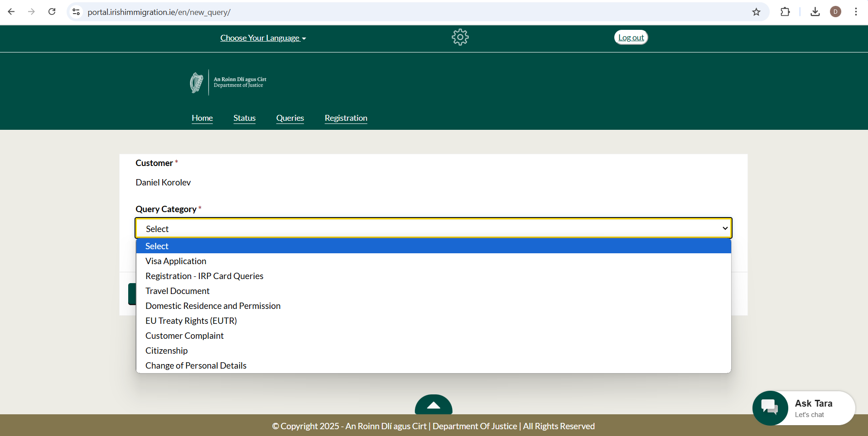
Heading/sub-heading
This smart children program targets underprivileged children, both children who are already smart and those who are not. Children will be given training and teaching by professional teachers and will be trained in dormitories provided by the institution. Children will also be given food with good nutrition and health facilities. The impact of this program is that more than 500 children have access to decent education and can continue our struggle further.
(questions about how to complete your visa application)
(ask about registering for your IRP card, follow up on submitted applications/errors)
(request the return of documents, register changes in address on documents, request emergency documents)
(ask about eligibility for applications, submit applications like Reactivation, spouse of Irish national, etc)
(ask about eligibility, how to change your permission and what application to submit, no applications to EUTR on portal)
(raise a complaint with immigration)
(ask about applying for citizenship, follow up on existing citizenship applications, evetting, etc.)
(change of address, name, or contact information on existing applications)

Slide 19
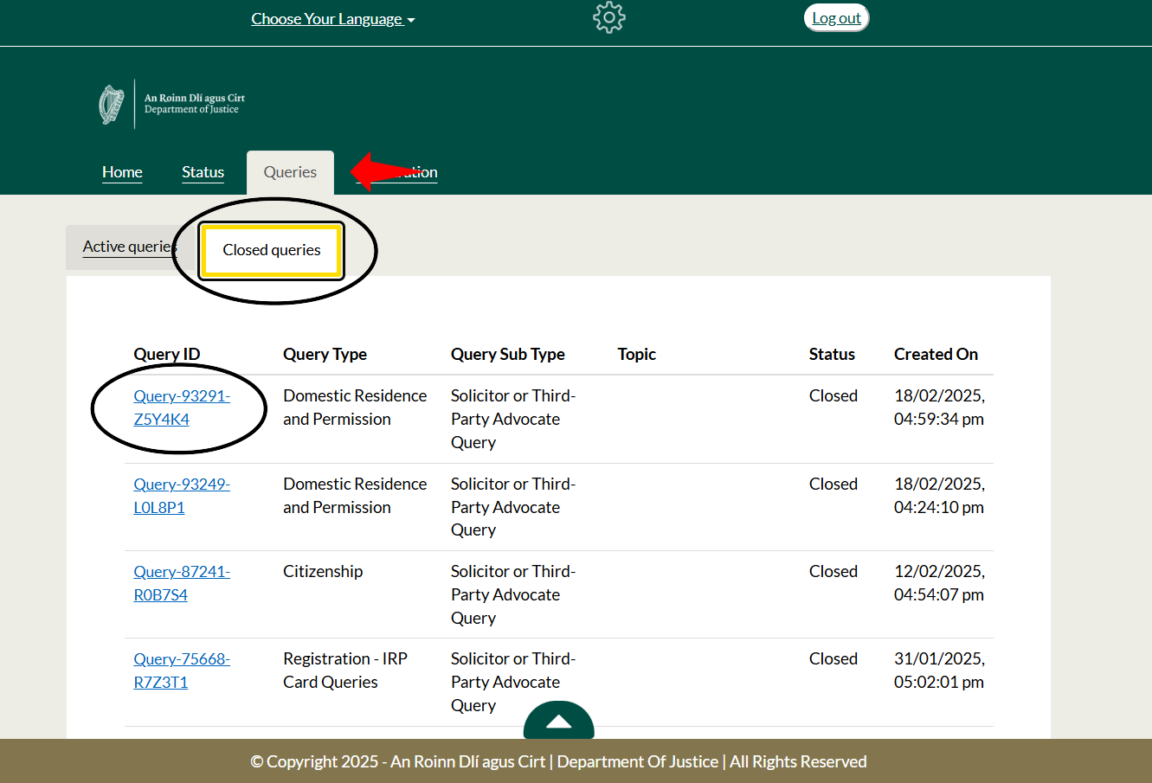
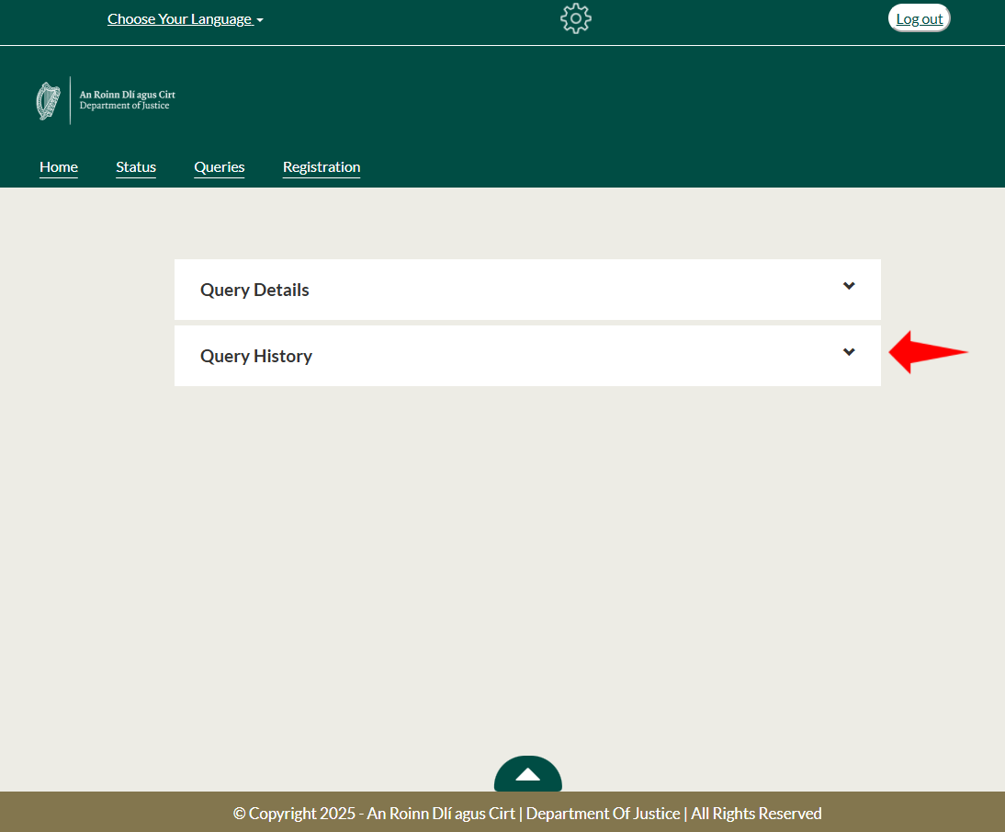
4. How To Submit An Application/ Query
When you receive an answer, you will receive an email stating your query is closed.
Log back on to the portal, click the ‘Queries’ tab, ‘Closed queries’, click the blue number under ‘Query ID’ (Photo 1).
Next click on the ‘Query History’ arrow (Photo 2) and you will see the answer to your query.
Option to reopen query available if follow-up is required.

Slide 20
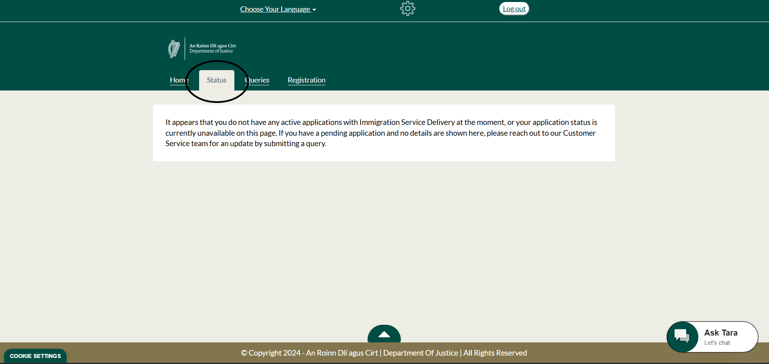
5. Check on the Status of an Application
To check on the status of an already submitted application, click on the ‘Status’ tab (shown above).
This will show a drop-down menu of all pending applications and their status.
If your application is not showing there, submit a query to the relevant department.

Slide 21
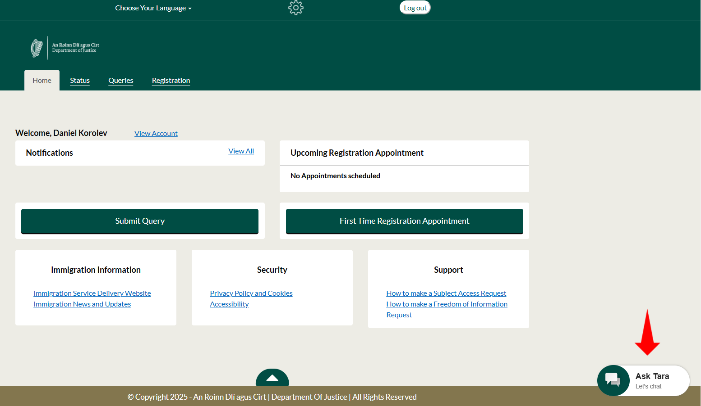
6. Useful Tips and Known Issues
Useful Tips:
‘Choose Your Language’ feature at the top of the page.
If you do not have a passport to make an account, email immigrationportalsupport@justice.ie.
Guide recently released by DOJ on using the portal (see link in ‘More Links’ slide).
If scanning ID is not working, choose ‘manual capture’ to take a photo instead.
For basic non-personal questions (i.e. “how do I apply for reactivation?”) use Tara AI chatbot (See photo).
Change phone number by pressing ‘View Account’ on home page.
Portal can be used identically on laptop/PC or smartphone.
When following up on an application, make sure to quote a reference number or Application ID.

Slide 22
6. Useful Tips and Known Issues
Known Issues:
ID scan can be difficult, make sure there is no light glare or blur. Photocopies of ID not accepted.
If you receive a message that your link has expired for ID-PAL verification, email IDPalSupport@Justice.ie.
Only one document can be attached to query/application, use websites to merge PDF files (see example in ‘More Info’).
Regular error when trying to verify mobile or log in, ‘you have reached the limit of text messages’. Wait and try again another time.
ID verification can regularly be rejected. If you have a continuous issue with ID-PAL, email IDPalSupport@Justice.ie. Response times vary.
We are aware of driving licenses not working for ID-PAL, passport is the best option.

Slide 23
Information and Support Centre
www.mrci.ie/contact-us
Our Information and Support Centre is currently running on an appointment basis.
If you would like to speak to us, the best way to get in touch is by sending us a message via the Contact Page on our website!

Slide 24
More Info / links
Related Links:
Immigration Customer Service Portal: https://portal.irishimmigration.ie/en/
Customer Service Portal Guide Document: https://www.irishimmigration.ie/customer-service-portal-a-guide-to-using-the-online-self-service-portal/
Useful Resources:
PDF Merging Tool: https://www.ilovepdf.com/merge_pdf
ISD Portal (use still for renewing IRP cards, applying for Citizenship, and others): https://inisonline.jahs.ie/user/login
MRCI Contact Us Page: https://www.mrci.ie/contact-us/

Slide 25
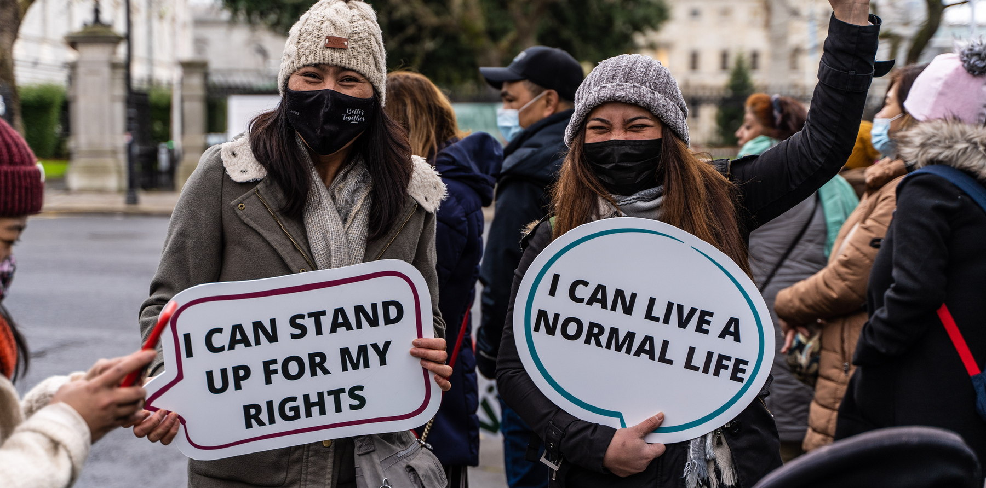
Join our campaigns
www.mrci.ie/our-work
Get Involved
Sign up as a supporter
www.mrci.ie/#signup
Donate
www.mrci.ie/donate
Join Us Today!

Slide 26
For Regular Updates
Follow us on Social Media
Website
www.mrci.ie

Slide 27
THANK YOU

