Slide 1
Change of Employer Webinar
13th November 2024
Prepared by Migrant Rights Centre Ireland

Slide 2
Migrant Rights Centre Ireland
MRCI is a national organisation working to advance the rights of migrant workers and their families at risk of exploitation, social exclusion and discrimination.
MRCI handle up to 3,500 cases a year through our national Drop-In Centre, which is a free and confidential service. We provide information, support, and advocacy on a wide variety of issues, including immigration rights and employment rights, via face-to-face, telephone, email and ongoing public awareness campaigns.
MRCI has been taking a stand with migrants to tackle the root causes of inequality since 2001.

Slide 3
Disclaimer
These materials have been prepared by the Migrant Rights Centre Ireland (MRCI) for information purposes only with no guarantee as to accuracy or applicability to a particular set of circumstances. The materials are not intended and should not be considered to be legal advice. The information given may change from time to time and may be out of date. The Migrant Rights Centre Ireland disclaims any legal responsibility for the content or the accuracy of the information provided. MRCI is not a practicing law centre.

Slide 4
Agenda
Employment Permit Act 2024.
What is Change of Employer?
What are the eligibility criteria?
What is a SOC code- Standard Occupational Classification?
What are the Requirements/Conditions?
Benefits of Change of Employer
How to apply?
Q&A

Slide 5
Employment Permit Act 2024
Signed into law by President Higgins on 25th June 2024.
Changes Employment Permit Act 2024, implemented on the 2nd of September 2024.
Other than Change of Employer, changes made to Labour Market Needs Test (LMNT), introduction of Seasonal Employment Permits, among other changes.

Slide 6
What is Change of Employer?
It allows employment permit holders to change employers by applying to the Department of Enterprise, Trade, and Employment (DETE) after a period of 9 months has passed since commencing their employment permit in the State.
Exceptional Circumstances allow for applications with less than 9 months employment.

Slide 7
What are the eligibility criteria?
Currently holding either General or Critical Skills Employment Permit.
Nine-months working for the employer.
In exceptional cases of exploitation or major changes to your employment situation you might be eligible to apply, e.g. the hours that you work are being significantly changed.
Permit must be valid and have at least 2 months validity remaining.
The new role must be within the same type of employment –same SOC Code.

Slide 8
What is a SOC code?
The Standard Occupational Classification (SOC) code.
Assigns all jobs a four-digit code based on skills and qualifications needed for the job.
GEP holders can apply to change employers within the type of employment identified they are already in. Essentially must work in the same role, minimal scope for change.

Slide 9
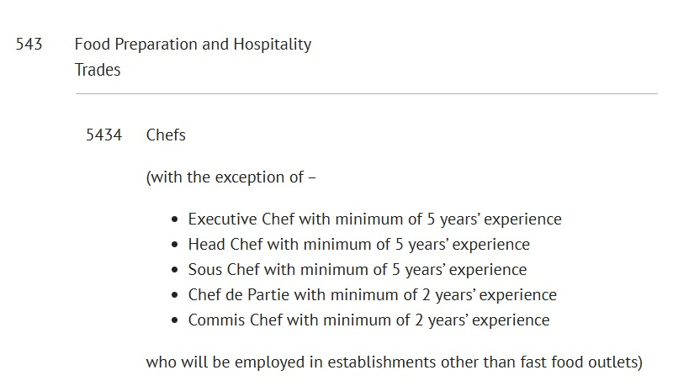
General Permit SOC Code Example

Slide 10
Changing Employer on Critical Skills
CSEP holders can change to an employer across a broader category of employment, for example, different engineering roles ( identified by its 3-digit SOC code).
For Example Soc code 211- Natural and Social Science Professionals. Chemical scientist, medical laboratory scientist, biological scientist and biochemist, physical scientist in manufacturing etc.

Slide 11
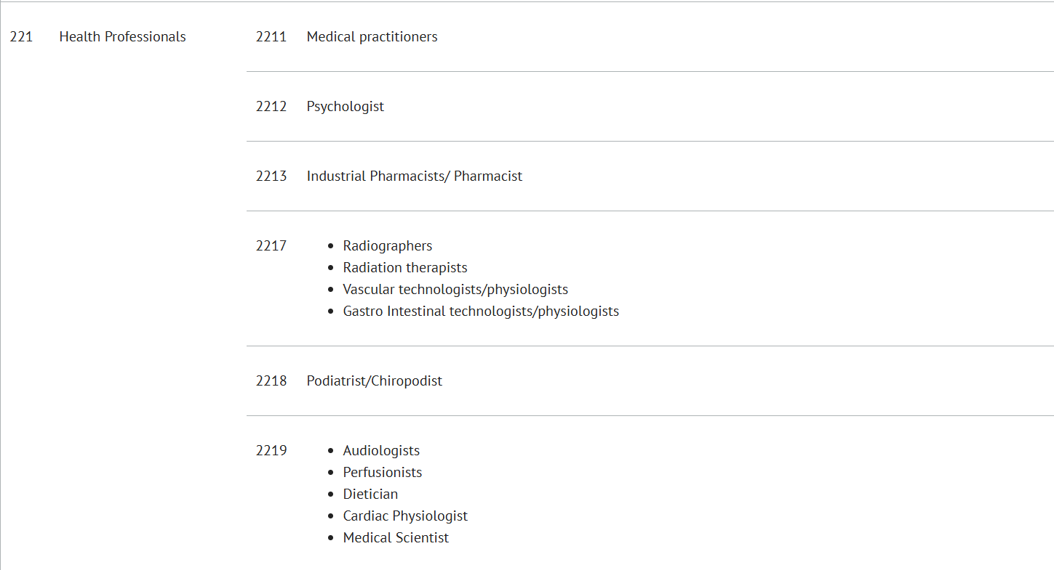
Critical Skills SOC Code Example

Slide 12
What are the key conditions?
Number of changes allowed – can change employer up to 3 times.
Contract of Employment – a new contract signed by the employer and employee.
NO New Labour Market Needs Test (LMNT) required.
The employee is required to commence employment with the new employer within one month of the new permit being issued.
It is important to note that the new employee cannot start working until the employment permit has been reissued.

Slide 13
Benefits of Change of Employer?
No reason needed to change employer after 9 months.
Potential way out of exploitative workplace.
No Labour Market Needs Test (LMNT) required.
No fee for this process and relatively short processing times.

Slide 14
Change of Employer Application Step-by-step guide

Slide 15
Application Process
Prepare the Required Documentation
Completed and signed application form
A signed contract of employment with NEW employer
A statement issued by the Revenue Commissioners showing the monthly statutory returns made by the employer dated within the 3-month period preceding the application
Additional documents required if the new employer is operating a restaurant business such as:
letter from the Local Health Authority,
statement from the employer that the worker will be employed in an establishment, and
copies of utility bills for the establishment premises dated 2 months period prior to application

Slide 16
How to Submit?
Completed and signed applications, together with a new signed contract of employment should be submitted to the dedicated email address: eptransfer@enterprise.gov.ie

Slide 17
Where can I find more information?
You can find more details about the Change of Employer at the following links:
Department of Enterprise, Trade and Employment Change of Employer
APPLICATION FORM CHANGE OF EMPLOYER

Slide 18
Other Helpful Tips
Some questions are difficult to answer yourself, ask new employers who are willing to support your employment permit for support.
The best thing is to share the DETE link or this presentation with a new prospective employer.
Do not leave the employer until Change of Employer is processed!

Slide 19
More Questions?
Contact the Department of Enterprise, Trade, and Employment – eptransfer@enterprise.gov.ie/info@enterprise.gov.ie
You can also send further queries to the MRCI website contact page.

Slide 20
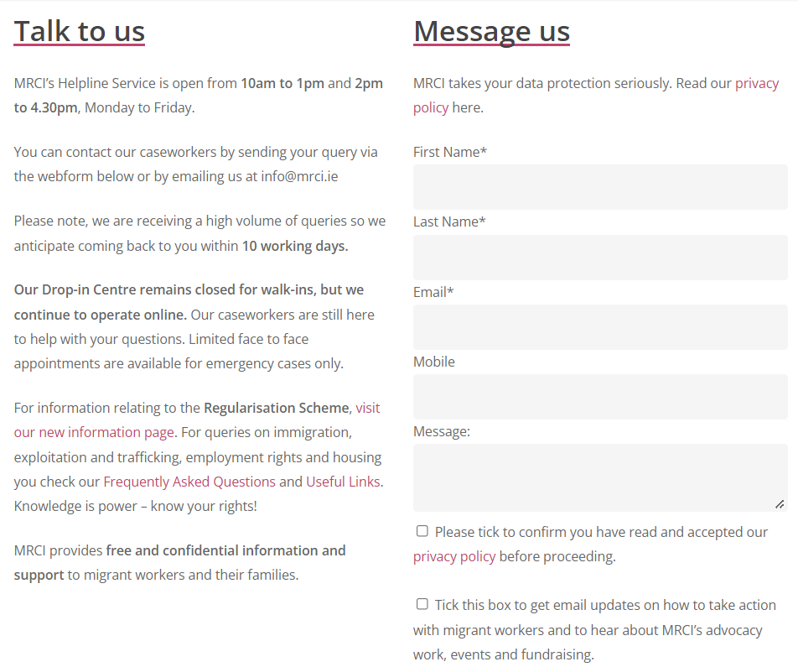
MRCI Drop in Centre
Our Centre is currently running on an appointment basis.
If you would like to speak to us, the best way to get in touch is by sending us a message via the Contact Page on our website!

Slide 21
Are You Feeling Exploited At Work?
Are you being treated badly at work?
Is Change of Employer not an option for you?
Please contact us for confidential guidance and support: https://www.mrci.ie/labour-exploitation-contact-us/

Slide 22
Useful Links
DETE- Change of Employer Website Page
Application form for Change of Employer Scheme
Critical Skills Occupation List (Includes SOC codes for CSEP)
More information on Employment Permits Act 2024
MRCI Contact Us Page
Contact MRCI if you are mistreated at work

Slide 23
Thank you so much for joining us!

