Slide 1

Employment Permits
17th of July 2024
Prepared by Migrant Rights Centre Ireland

Slide 2
Migrant Rights Centre Ireland
MRCI is a national organisation working to advance the rights of migrant workers and their families at risk of exploitation, social exclusion and discrimination.
MRCI handle up to 3,500 cases a year through our national Drop-In Centre, which is a free and confidential service. We provide information, support, and advocacy on a wide variety of issues, including immigration rights and employment rights, via face-to-face, telephone, email and ongoing public awareness campaigns.
MRCI has been taking a stand with migrants to tackle the root causes of inequality since 2001.

Slide 3
Disclaimer
These materials have been prepared by the Migrant Rights Centre Ireland (MRCI) for information purposes only with no guarantee as to accuracy or applicability to a particular set of circumstances. The materials are not intended and should not be considered to be legal advice. The information given may change from time to time and may be out of date. The Migrant Rights Centre Ireland disclaims any legal responsibility for the content or the accuracy of the information provided. MRCI is not a practising law centre.

Slide 4
Agenda
Who can apply for employment Permit?
Types of Employment permits
Reactivation Employment permit
Benefits REP scheme
Who is eligible?
How to apply?
Employment Permit Bill 2022- Change of Employer
Q & A

Slide 5
What is an Employment Permit ?
Employment Permit – allows the Non-EEA national to work in the State in a broad range of occupations, unless they are exempted , for example stamp 4 holder
Issued by Department of Enterprise, Trade and Employment - DETE

Slide 6
Who can apply Employment Permit while in Ireland ?
You must hold a valid certificate of Registration Irish Residence Permit (IRP/GNIB) with permission on stamp 1, 1A, stamp 1G， stamp 2, 2A, or 3 to submit an employment permit application.
CANNOT APPLY IF YOU HAVE NO LEGAL STATUS/UNDOCUMENTED

Slide 7
PERMIT TYPES/SCHEME
DETE
DOJ/Scheme
9 types of Employment Permits
  Critical Skills
  Intra-Company Transfer
  Dependant/Partner/Spousal (DPS)
  General Employment Permit
  Contract For Services
  Reactivation Employment Permit
  Internship
  Sports and Cultural
  Exchange Agreements
Atypical Working Scheme (AWS)-(generally less than 90 days)
Doctor providing locum services in the Hospital Sector - 6 months
Nurse seeking NMBI (Nursing and Midwifery Board of Ireland) registration based on overseas qualification-6 months, nonrenewable
More than 90 days DETE
Other Permission letters

Slide 8
Reactivation Employment Permit Scheme Application (REP)
What is it?
IS FOR Employment permit holders who have fallen out of the employment permit system through no fault of their own
OR Who have been mistreated or exploited by their employer.

Slide 9
What are the Benefits of the REP scheme?
You will be granted a temporary Stamp 1 permission for 6 months
No labour market needs test involved in the new permit - LMNT
The permit can be issued for any job in any sector, including certain carers in the home, (excluding all other occupations in a domestic setting)
Salary is at or above the minimum wage.

Slide 10
Who is eligible?
If you previously held an employment permit to work in Ireland or you currently hold an employment permit
You could not renew your employment permit through no fault of your own or
Because you were mistreated or exploited by your employer.

Slide 11
Reactivation Employment Permit (REP) Scheme Application
Step-by-step guide

Slide 12
How to apply?
The REP scheme is a two-step process involving two departments.
Step 1: You MUST first apply through Immigration Service Delivery (ISD)
which is part of the Department of Justice.
You need to complete the REP application form, found on ISD website
You will receive an approval letter from ISD which will allow you to apply for REP, Step 2.
You will be granted temporary permission Stamp 1 for 6 months.

Slide 13
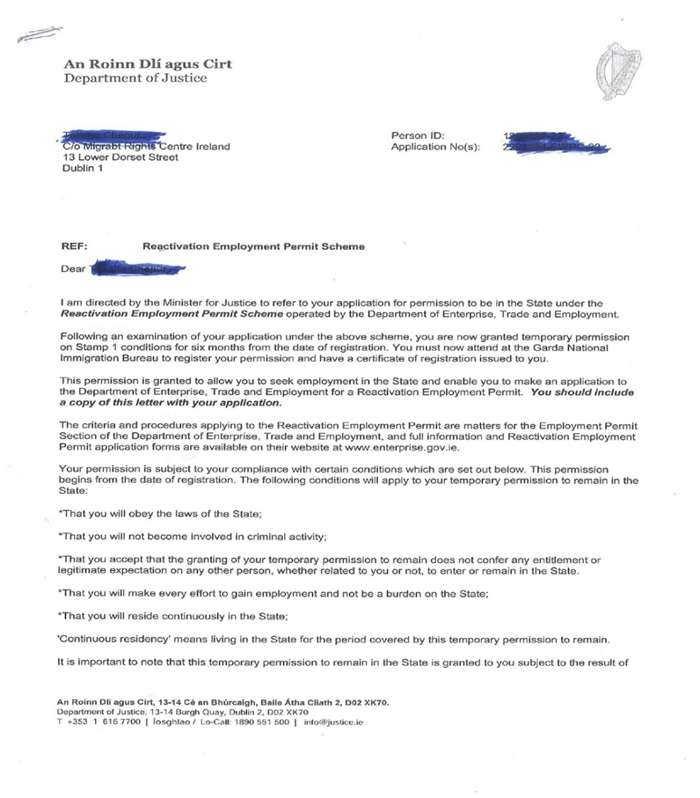
Letter from ISD

Slide 14
How to apply?
Step 2: New Reactivation Employment Permit through the
Department of Enterprise, Trade and Employment (DETE).
You need to use the online portal to apply for this permit, DETE website
“Reactivation Employment Permit – Standard employer/Trusted partner（ New） ”
You will need to upload several important documents with this online
application such as your permission letter received from ISD,
a passport-sized photo, a signed application form, and others.

Slide 15
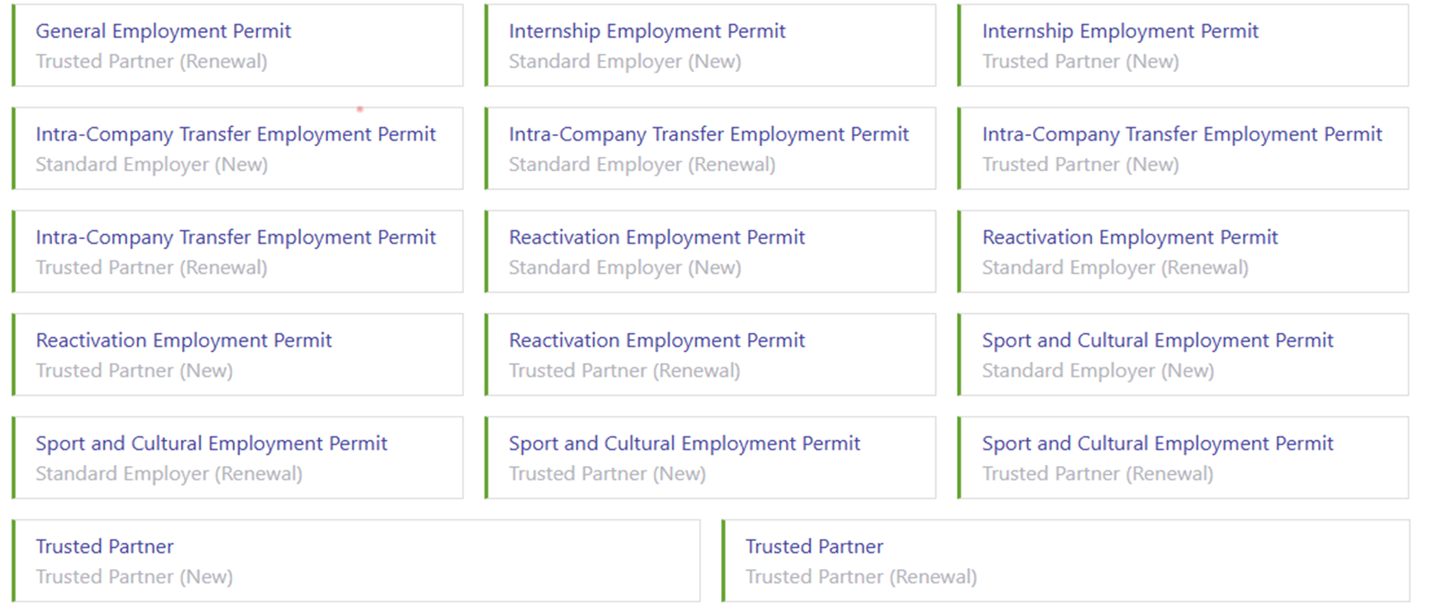


Employment Permit Online System

Slide 16
Who pays for the new reactivation employment permit?
DETE charges €1,000 for a 2-year permit
Permit can be paid for by the applicant (the employee) or by the company employing them (the employer).

Slide 17
Where can I find more information?
You can find more details about the REP scheme at the following government websites:
Department of Enterprise, Trade and Employment – REP scheme page
Immigration Service Delivery (Dept. of Justice) – REP scheme page

Slide 18
Do you have any other tips that will help?
New employers who are willing to support your employment permit
The best thing is to share the DETE and ISD links above or this page with a new prospective employer

Slide 19
Employment Permit Act 2024
Signed into law by President Higgins on 25 June2024
Among other measures, the new legislation will grant workers on employment permits the freedom to change employer after a period of nine months has elapsed or the hours that you work are being significantly changed.
Implementation –TBA
MRCI urge Minister Emer Higgins to quickly put in place the new procedures necessary to enable people to change employer

Slide 20
More questions?
You can contact the two Departments involved:
Department of Enterprise, Trade, and Employment-REP Scheme Page
Immigration Service Delivery ( Department of Justice) – REP Scheme page
You can also send further queries to MRCI website contact page
contact-us.

Slide 21
Employment permits checklists
DETE Reactivation Employment Permit
Reactivation Scheme Temporary permission
User Guide for Employment permit application
You can check the status of your application using the online status enquiry facility.
The application processing times are on the Department of Enterprise, Trade and Employment’s website.

Slide 22
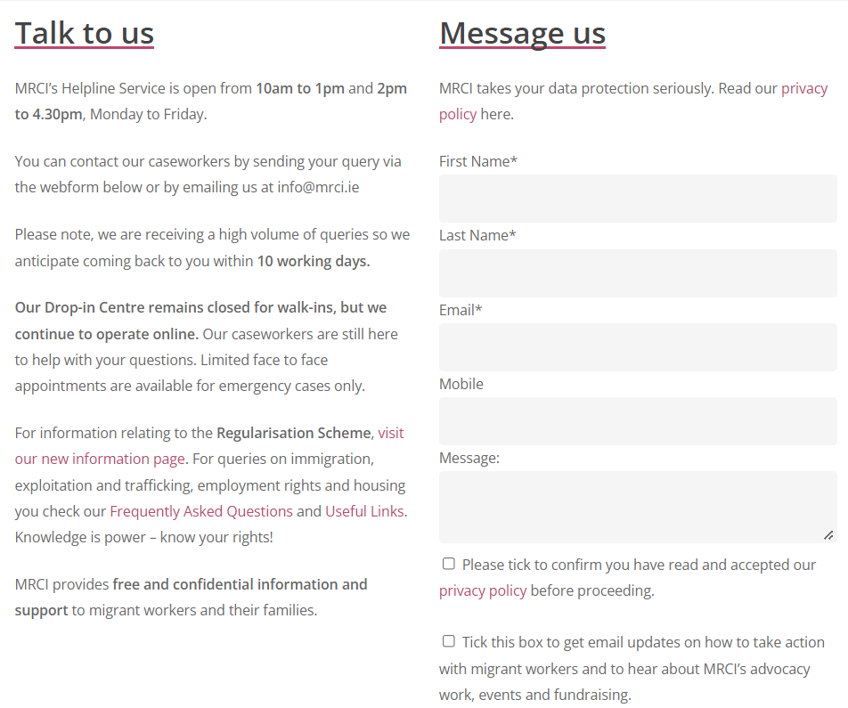
Drop in Centre
Our Centre is currently running on an appointment basis.
If you would like to speak to us, the best way to get in touch is by sending us a message via the Contact Page on our website!

Slide 23
Campaign for a fairer Employment Permit System
Do you currently hold an Employment Permit here in Ireland? Do you want to meet other workers and fight for your rights? Then join the campaign!
www.mrci.ie/join-employment-permits-campaign/

Slide 24
Thank you so much for joining us!

